Slide 1




한-인니 항공산업 협력방안
2010. 11

Slide 2
Reinforcement Strategy for Indonesia-Korea Aerospace Industrial Cooperation
2010. 11

Slide 3

제 출 문
KOTRA 사장 귀하
본 보고서를 “한-인니 항공산업 협력방안" 용역과제의 최종보고서로 제출합니다.
2010년 11월
산업연구원 원장 송 병 준

Slide 4
연 구 진
연구책임자
산업연구원 연구위원 안영수
연구수행자
산업연구원 연구위원 안영수
연구위원 이경숙
연구위원 김종기
부연구위원 민혁기

Slide 5







Contents
Characteristics of Aerospace Industry
and International Industrial Cooperation
Case Studies of International Industrial
Cooperation in Aerospace Industry
Analysis of Indonesia and Korea’s Aerospace
Industries and Future Potential
Trade and Investment between Indonesia-Korea
Reinforcement Strategy for Indonesia-Korea
Aerospace Industrial Cooperation
Summary and Policy Suggestions
*Attached : Candidate company lists for components

Slide 6
Characteristics of Aerospace Industry
and International Industrial Cooperation

Slide 7
I. Characteristics of Aerospace Industry and International
Industrial Cooperation
A. Strategy-generating process for Aerospace Industrial Cooperation between Indonesia-Korea
MKE Officer visited to Indonesian Government to increase cooperation between Indonesia and Korea (08. 2010)
MKE Operates TF and organizes Meeting to create Aerospace Industrial Cooperation between Indonesia-Korea (08.2010)
  Gov: MKE, KODITS
  Research Inst: KIET(Policy), KARI(Aerospace Engineering)
  Companies: Korean leading company, part and Equipment companies
Visit to Indonesia to Identify Industrial Cooperation Possibilities (08.31-09.03.2010)
  Visited Members: MKE, KIET, KARI, KAIA, KOTRA
  Visit to: MOI, IAe, BPPT, Korean Embassy
  Meeting with Indonesian Cooperating Companies (09.08.2010) - MKE, KIET, KARI, KAIA, KOTRA, Korean Aerospace companies
MOI of Indonesia Visited Korea (09.15-16.2010)
    MKE Meeting and Visit to KAI
    Delivered lists of Korean Candidate Companies for Cooperation
Received feedback on Information and Data from Indonesian Embassy and Indonesian Branch of KOTRA (09.10-10.22.2010)

Slide 8
I. Characteristics of Aerospace Industry and International
Industrial Cooperation
B. Characteristics of Aerospace Industry
Bilateral Monopoly by Seller and Buyer
  Government or few Aerospace Companies as Buyers and Single provider for achievement of Economies of Scale
  High Entry Barrier to new Entrant
High Importance of Creating Economies of Scale
  Economies of Scale is very important due to enormous investment and characteristics of equipment industry
Risks of High R&D and Investment Costs
  High Risk because of Enormous Investment in Development and Difficulty of Achieving Economies of Scale
  * B787 Development Costs :13 billion dollars, T-50 Development Costs: 2.1 billion dollars
  Spillover Effect on National Economy through High-Tech Industrial Development
    Development of Other Industries through High Technical Spillover Effect
    Maximizing Synergy effect for civil and military technologies
    Huge Industrial Spillover Effect and Employment of High Quality R&D Workers: Accelerating Advanced Industrial Structure

Slide 9
I. Characteristics of Aerospace Industry and International
Industrial Cooperation
C. Significance of International Aerospace Industrial Cooperation
Increase of Mutual Interests through Intra-industry Division
  Co-development Projects such as Boeing or Airbus
  Overcoming Limits from Shortage of Individual Nation’s Resources and Capabilities and Creating Synergy Effects
  Enhancement of Technical Skills by Co-development
Risk Reduction of Large-Scale through Composition of International Consortium
  Civil Aircraft: Boeing series (U.S, Italy, Japan), Airbus series (France, Germany, England, Spain)
  Military Aircraft: JSF(led by U.S.), EF2000(led by Europe)
Promotion of Various Types of Industrial Cooperation
  International Subcontracting for Cost Reduction and Risk Sharing
  Co-development for Risk Sharing and Capturing the markets
  JV Establishment for Technology Acquisition and Co-marketing

Slide 10
Case Studies of International Industrial
Cooperation in Aerospace Industry

Slide 11

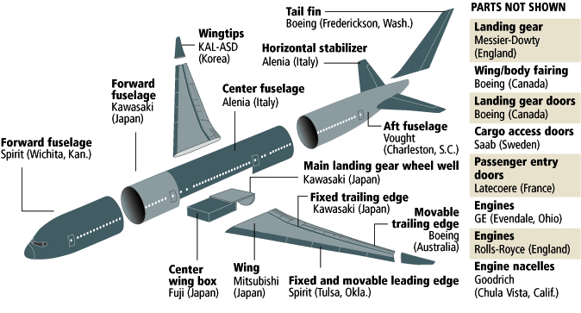
II. Case Studies of International Industrial Cooperation in Aerospace Industry
A. Boeing 787
Joint development Co-developing Companies: U.S. (10.5 billion dollars, 79.1%), Italy( 0.49 billion dollars, 3.7%), Japan (2.3 billion dollars, 17.2%)
  Korea’s (KAL, KAI) Work Share: Approximately 1.5%
Total 819 Aircraft Orders up to 2009 after the First 52 Aircraft Orders in 2004
  Launch order of 50 Aircraft by ANA, Japanese Company
Japan supplies composites for B -787 program(3 billion dollars)
National Shares for B-787
National Participation for B-787
Unit: billion dollars, %
Nation | Amount | Share
U.S. | 10.5 | 79.1
Italy | 0.49 | 3.7
Japan | 2.3 | 17.2
Total | 13.29 | 100

Slide 12
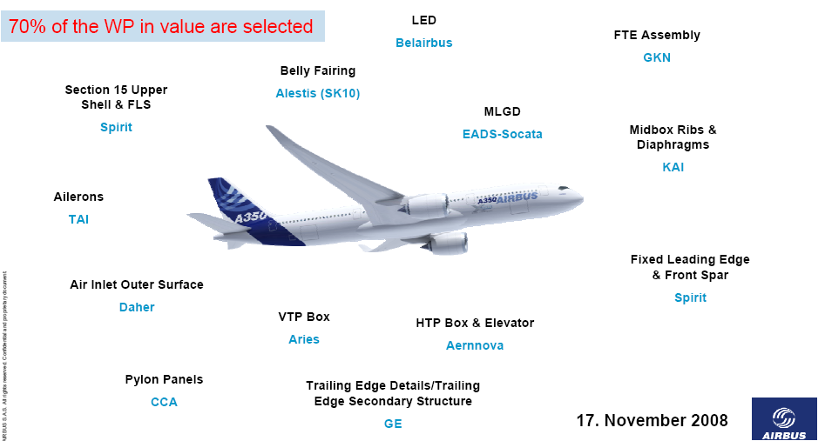
II. Case Studies of International Industrial Cooperation in Aerospace Industry
B. Airbus 350XWB
Companies from 7 Nations Participated including EADS(80%), BAE Systems(20%)
  EADS is an European Enterprise Composed of France/Germany/Spain.
  U.S.A, Turkey and Belgium also Participated.
  KAI of Korea participated as RSP for French Airbuses, Secured Production Quantity of $1.2B.
Obtained Orders for total 573 until now. (Expected to deliver in 2013)
Participation of Companies in A-350XWB

Slide 13
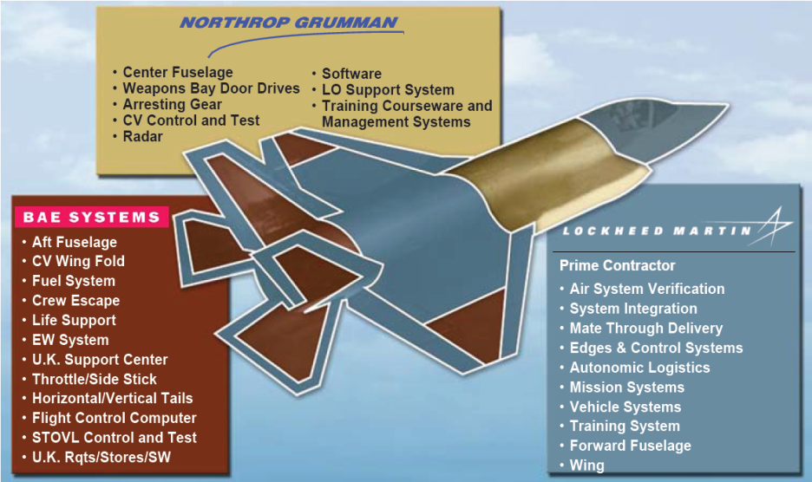
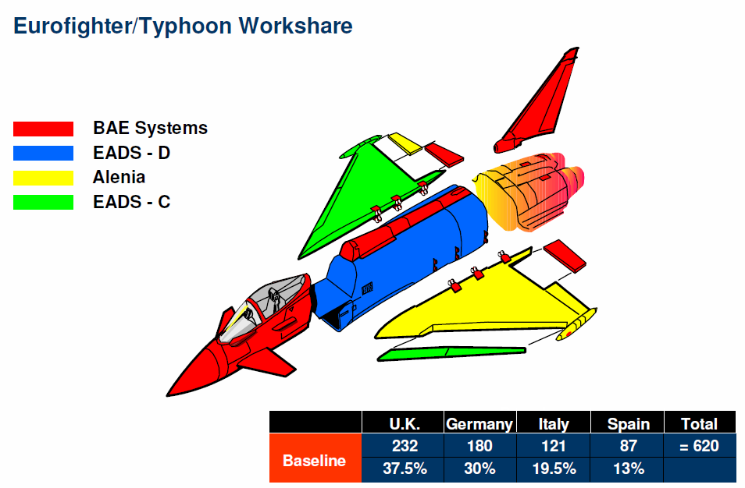
II. Case Studies of International Industrial Cooperation in Aerospace Industry
C. Development Projects on Military Aircraft
JSF-35(U.S.)
  Participating Nations (9 nations): U.S., England, Italy, Netherlands, Turkey, Australia, Norway, Denmark, Canada
  Development Costs: 44.4 billion dollars - Partial Assembly (California, Texas, England), Final Assembly (Texas)
  Total Production Amount: 3,185 (2,443 in U.S.)
EF2000(Europe)
  Participating Nations: England, Germany (33% each), Italy (21%), Spain (13%)
  Development Costs: 3.3 billion pounds
  Partial Assembly in 4 nations, Final Assembly in England
  Total Production Amount: 620 (distributed by participation rate), 15 Aircraft were exported to the Third Nations

Slide 14
II. Case Studies of International Industrial Cooperation in Aerospace Industry
D. Implications
Preparing Investment Resources and Risk Sharing for Investment and Development
  Increase of Investment Risks due to Enormous Development Cost
  (Ex) Civil Aircraft: B-787 :13 billion dollars
  Military Aircraft: JSF: 44.4 billion dollars
Securing Profitability through Economies of Scale
  Creating the Economies of Scale by Securing Markets participating Nations
  (Ex) Civil Aircraft(B-787) : Secured Launch Order through inducing orders of ANA, Japan
  Military Aircraft(JSF,EF2000) : Launching Business with Secured Demand of Governments
  participating in Program
Securing competitiveness through Development and Co-Research with consideration of Developers’ Strengths
  Enhance Competitiveness with developments based on each strengths
  Secure competitiveness through co-research among nations
  * Maximizing synergy effect by participating in major projects
  Provide opportunities for technology obtainment

Slide 15
Analysis of Indonesia and Korea’s Aerospace
Industries and Future Potential

Slide 16

III. Analysis of Indonesia and Korea’s Aerospace Industries and Future Potential
A. Indonesian Aerospace Industry and Development Potential
1) Demand and Number of Passenger Aircraft
18 operating airlines due to Deregulations since 2000s.
Total Number of Passenger aircrafts: 245
  Garuda Airways possesses 54 passenger aircraft (22.0% of total)
  4 airlines including Lion Airlines made up 57.6% of total.
Total 274 passenger aircrafts were ordered due to increasing demand for passenger aircraft
  Lion Airlines: 165, Garuda: 74 (expected to deliver 24 this year)
  Merpata Airline ordered 10 (NC-212, produced by IAe, Indonesia)
Number of Aircraft Operations and Orders of Indonesian Airliners (2009)
Division | Garuda | Lion Airlines | Merpata | Betavia Air | Others | Total
Number of Aircrafts | 54(22.0) | 23(13.1) | 31(13) | 24(9.8) | 104(42.4) | 245(100)
Order | 74 | 165 | 10 | 0 | 25 | 274

Slide 17
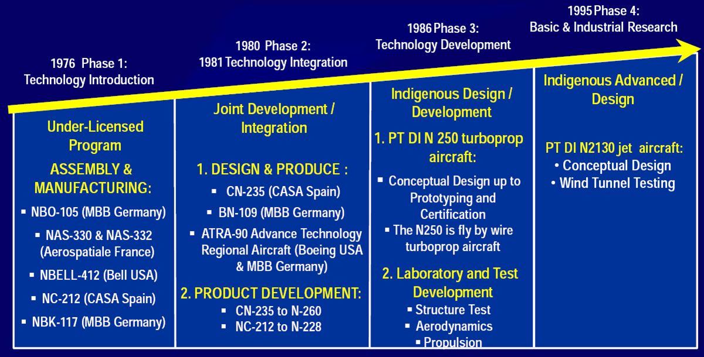
III. Analysis of Indonesia and Korea’s Aerospace Industries and Future Potential
A. Indonesian Aerospace Industry and Development Potential
2) Development Phases of Aerospace Industry

Slide 18
III. Analysis of Indonesia and Korea’s Aerospace Industries and Future Potential
A. Indonesian Aerospace Industry and Development Potential
3) Current Status of Aerospace Industry
Annual Production: 120 Million Dollars, Annual Exports: 25~30 Million Dollars
  20~25% of production is exported.
Employment: approximately 4,000 persons, 650 of them are high class R&D engineers.
After great restructuring at the time of IMF, overall industrial production and employment were reduced to 25~30% compared to those in 1997
  Many development businesses were stopped. (N-250(70-Seater Turbo Prop, N-2130
  (100-Seater Jet))
Revitalizing with recent promotion of new moth plane business (N-219) and military aircraft businesses
Current Status of IAe (2009)
Division | Sales | Exports | Employment (persons)
Million $ | 120 | 25~30 | 3,700(650)
* ( ) shows number of engineers.

Slide 19
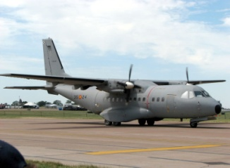
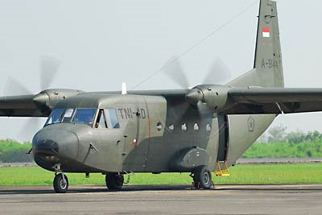
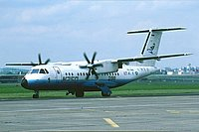

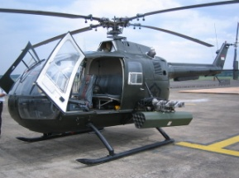
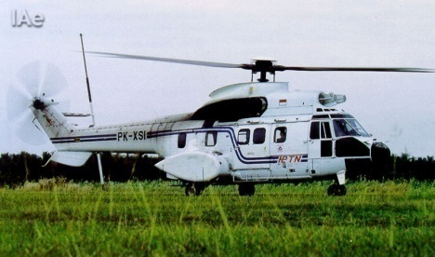
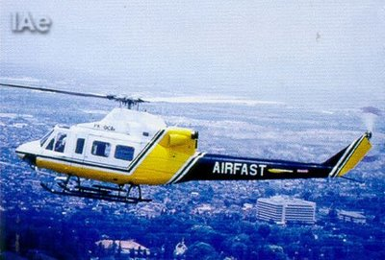
III. Analysis of Indonesia and Korea’s Aerospace Industries and Future Potential
A. Indonesian Aerospace Industry and Development Potential
4) Main Products
Fixed Wing Aircraft
CN-235
NC212
N-250-prototype
N-2130-planned
Rotary Wing
NBO-150
NAS 332
NBell 412
Airframes
Component of Boeing 737.
Component of Boeing 757.
Component of Boeing 767.
Component of F-16 Fighting Falcon
Component of Airbus A330.
Component of Airbus A340.
Wing Component of Airbus A380.

Slide 20
III. Analysis of Indonesia and Korea’s Aerospace Industries and Future Potential
A. Indonesian Aerospace Industry and Development Potential
5) Potential
Demand
  Demand for passenger planes increased because increasing demand for overseas tours raised flight demand.
    Expected number of orders is about 270 passenger planes in the coming 5 years.
    Competitiveness will be secured fast if the needs for passenger aircraft is connected to
    development of aerospace industry.
  Demand is great considering transportation connections between many islands.
  (about 17,000 islands)
Development Capability
  Rich capacity of high class R&D engineers and possession of developmental capacity of 70-Seater
  Turbo Prop and 100-Seater Regional Jet
Production Capacity
  Easy to secure price competitiveness in the global parts market with labor force with comparatively low costs.

Slide 21
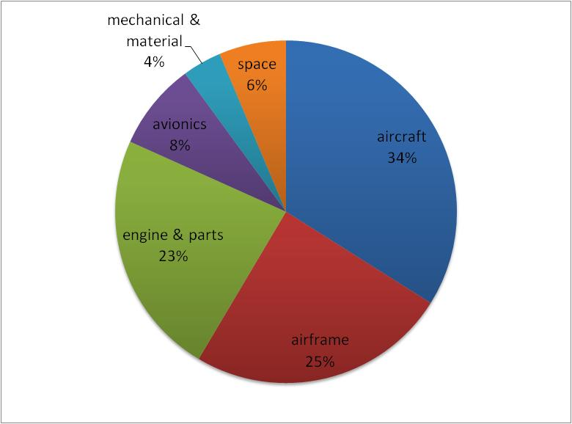
III. Analysis of Indonesia and Korea’s Aerospace Industries and Future Potential
B. Korean Aerospace Industry
1) Facts & Figures
Revenue : $1,970m
Imports : $ 1,960m
Domestic : $ 3,170m
Exports : $ 760m
Civil Sales : $ 700m
Military Sales : $1,300m
Employments : 9,780
Annual Performance
Sectoral Performance
[2010. Korea Aerospace Industries Association]
[2010. Korea Aerospace Industries Association]

Slide 22
III. Analysis of Indonesia and Korea’s Aerospace Industries and Future Potential
B. Korean Aerospace Industry
2) Companies
About 110 companies are participating in overall aerospace system, engines, airframe components and materials. 10 thousand employees. Sales sum of 3 companies (KAI, Samsung Teckwin, KAL) is 80% of the total industry sales.
  KAI : System Integration
  Samsung Techwin: Engine
  KAL : Airframe
Korea Leading Companies
Company | KAI | KAL | Techwin | Hanwha | Nexwon | WIA
Revenue (M$, 2008) | 762 | 454 | 509 | 61 | 39 | 21
Main products | Military Aircraft | Airframe | Engine & components | Hydraulics | Avionics | Landing Gear
Employments
Total : 9,780
Admin. 2,098 | Engineers 2,067 | Technician 2,452 | Manufacturer 3,172

Slide 23


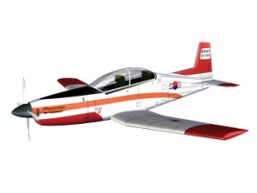
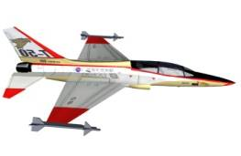
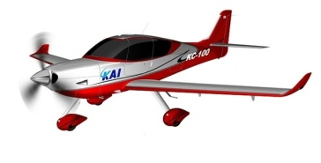

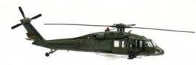
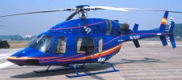
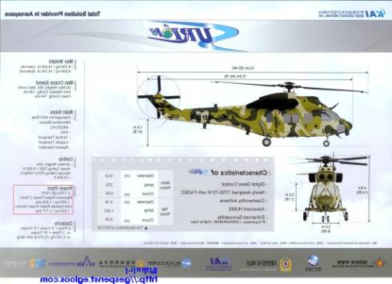

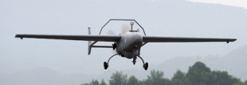
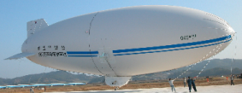
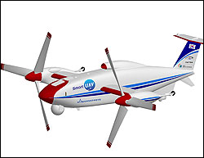

III. Analysis of Indonesia and Korea’s Aerospace Industries and Future Potential
B. Korean Aerospace Industry
3) Major Projects
1990
2000
2010
KF-16
KT-1
T-50
KC-100
Fixed
Wing
License Production
Development
UH-60
SB-427
KUH
Rotary
Wing
License Production
Development
RQ-101
Unmanned Airship
Unmanned Military Aircraft
Tilt-rotor
UAV
Development
Large aircraft
components
Large aircraft
components
B-787
A-350
GEnx Engine
Export
Production
Production
RSP

Slide 24
III. Analysis of Indonesia and Korea’s Aerospace Industries and Future Potential
B. Korean Aerospace Industry
4) Future Potential and Korea Aerospace Vision 2020
Goal : Become One of the World’s -Leading Countries in Aerospace Industry
by 2020
  Revenue : $20B (3% share of world market), Export : $10B
  Employments : 30,000+
  300+ companies in the industry
Detailed Strategy
  4 Aerospace Development Projects Promotion: Development cost – approximately $10B
    Military: The next generation military aircraft, attack helicopters
    Civil: Mid-sized planes, civilian demands
    Participating in RSP for large passenger planes and engines
  Participating in international co-developments
  Cultivation of MRO Industry
  Export promotion

Slide 25
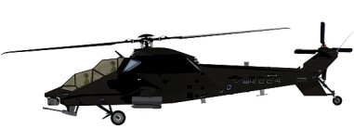
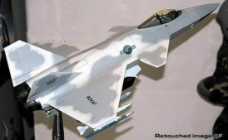
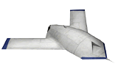
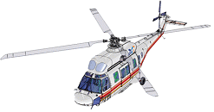
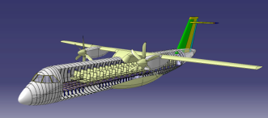
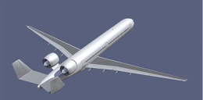
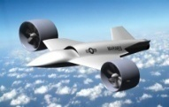
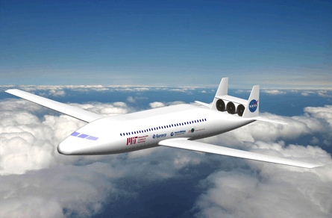
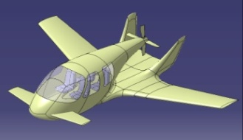

III. Analysis of Indonesia and Korea’s Aerospace Industries and Future Potential
B. Korean Aerospace Industry
5) Development Road-map
2015
2015
2020
2025
2020
Military
Program
KAH
KFX
UCAV
Civil
Program
Civil Rotor Craft
Regional Aircraft
Future Transport
R&D
Program
Intelligent UAV
Green Transport
Personal Air Vehicle
International Co-development
B-7 X 7, A 3 XX Series
Genx Engine
Large Engines
Privatization of Military MRO
Export of Worldwide Civil MRO
MRO

Slide 26
III. Analysis of Indonesia and Korea’s Aerospace Industries and Future Potential
C. Implications
Common Factors
Div. | National Characteristics |  | Industrial Characteristics
 | Region | Circumstances | Demand | Trade Balance | National Policy | R&D Manpower | Developmental Capacity for Complete Aircraft
Cont-ents | One-Asia | IMF crisis (1997) | · Development of aerospace industry · Similar possession of passenger planes | Serious loss in aerospace industry | High will of aerospace industry development | Possession of excellent R&D manpower | Indonesia: civil aircraft Korea: military aircraft
Differences
Until mid-90s, Indonesia was the Leader of Asian Aerospace Industry
  70s - CN-212 (24-Seater, Turbo Prop) license
  80s - CN-235 (45-Seater, Turbo Prop) co-development
  90s - CN-250 (70-Seater, Turbo Prop) independent development
Since 80s, Korea Continuously Developed
  ’70~’90 licensed production : F-5, F-16, UH-60 Helicopter
  ‘90~’00 : KT-1 development, Components Production with International Subcontracts
  ‘00~’10 : T-50 development , KHP Helicopter / FA -50 developing, Int’l RSP
  Solid Infrastructure (machinery, electronics, materials, communications, manufacture and commercialization capacity), many cooperating companies (110)

Slide 27
III. Analysis of Indonesia and Korea’s Aerospace Industries and Future Potential
C. Implications
Implications
Strong Interest for Development of Aerospace Industry
  Both nations have high wills for development of aerospace industry.
Possession of Excellent R&D Manpower
  Both nations have excellent R&D manpower for aircraft development
    Indonesia: about 700 persons
    Korea: about 2,000 persons
Possible Creation of Aircraft Demand with High Developmental Potentials.
  Indonesia: Demand for passenger planes was created by deregulation, tour demands and economic development.
  Korea: Demand for passenger planes increased with continuous economic development and industrialization.
High Synergy Effect will be Created with Mutual Cooperation.
  Maximization of synergy effect with mutual complementation.

Slide 28

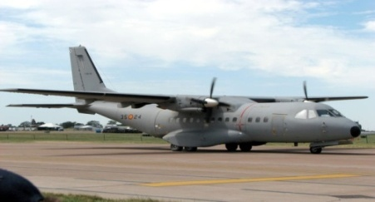
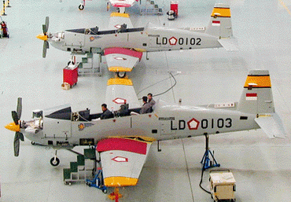
III. Analysis of Indonesia and Korea’s Aerospace Industries and Future Potential
D. Korea-Indonesia relationships in Aerospace
NC-235
Korea will operate 24 NC-235s by 2011
Korea Air Force operates 20 NC-235s
    12 CN-235-100M (since 1993)
    8 CN-235-220M (since 1997)
Korea Coast Guard introduces 4 CN-235s by 2011
KT-1B
Indonesia Air Force operates 12 KT-1B since 2003
    KT-1B is the Indonesian version of KT-1 basic trainer developed & produced by KAI
Aircraft Parts
B-737 Wing Rib Cooperative Production
  IAe – KAI, until ’01~’03
Future Jet Fighter
Indonesia and Korea plan to start a joint project on jet fighter development and production
Both countries signed a MOU for the future fighter development
(KFX project) at July/15/2010

Slide 29
Trade and Investment between Indonesia-Korea

Slide 30
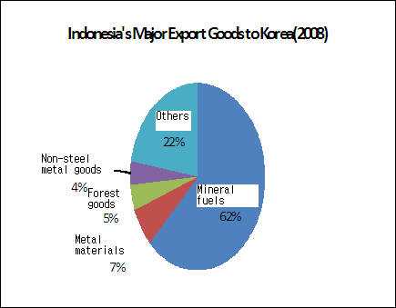
IV. Trade and Investment between Indonesia-Korea
A. Current Indonesia-Korea Trade Status
Import and Export Status of the Two Nations
  Indonesia: 12th exporting nation of Korea and 10th importing nation
  Korea: 5th exporting nation of Indonesia, 7th importing nation
Recent Trading Characteristics: Trade amount is increasing continuously
  Especially in last 5~6 years, trade amount increased rapidly
  Export and import of 2008 increased 126% and 114% compared to 2000

Slide 31
IV. Trade and Investment between Indonesia-Korea
B. Korea’s Investment to Indonesia
Indonesia’s 4th Highlight Nation for FDI
  $625m in 2009, 5.8% of Total FDI, Indonesia
  Mainly invested in Manufacturing industry (mainly in machinery and textile) and construction
Recently, Enormous Investment in Heavy Industry
  POSCO(a global company) built steel production factory of 6 billion dollars.
Machinery Electronics
Construction
Textile
Transport & Warehouse
Hotel & Restaurant
Others

Slide 32
IV. Trade and Investment between Indonesia-Korea
C. Current Indonesia-Korea Aerospace Trade Status
Total of Aerospace Trade for Past 10 Years: $126m
  Korean export amounts are larger than Indonesian export amounts
  If military aircraft and CN-235 are exported to Korea, the trade amount is expected to increase.
Increase of Korean Exportation in 2003 and 2007 occurred by sales of KT-1.
  Indonesian exports increased in 2003 occurred with CN-235 exports for Korean Air Force.
Trade Tendency of Indonesia-Korea Aerospace Industry
Unit: million $
Division | 2000 | 2003 | 2005 | 2007 | 2009 | Total (00-09)
Indonesia-import | 3.0 | 30.6 | 6.0 | 26.5 | 5.9 | 78.3
Indonesia-export | 0.0 | 42.5 | 0.3 | 0.3 | 0.4 | 47.8

Slide 33
IV. Trade and Investment between Indonesia-Korea
D. Implications
Indonesia-Korea Trade Amount is Continuously Increasing.
  Trade based on each nation’s strengths is increasing.
Indonesian Investment Increased largely with localizations of Korean companies.
  In the past, mainly on textile and needlework where labor was concentrated on
  Recently FDI increased in industries with large effect including steel, machinery and construction. Expected to contribute to industrial and economic development of Indonesia.
Possibility of Industrial Cooperation for Win-Win is Expected for Many Industries in the Future.
  Korea’s advanced technology, and Indonesia’s abundant demand and low cost labor force
Reinforcement of Industrial Cooperation in High-Tech Industries, especially Aerospace Industry, is Possible.

Slide 34
Reinforcement Strategy for Indonesia-Korea
Aerospace Industrial Cooperation

Slide 35
V. Reinforcement Strategy for Indonesia-Korea Aerospace
Industrial Cooperation
A. Basic Direction and Strengths
Basic Direction: Maximization of National Revenues by Win-Win
Mutual Complementary and Synergy Effects with Each Nation’s Strengths
Reinforcement of Industrial Competitiveness by Establishment of Strategic Partnership
  Development of Aerospace and Components Industries by Reinforcing Mutual Strategies
    Maximization demands and reinforcement of both nation’s government supports
    Co-development of Overseas Markets
Indonesia | Korea
Company: major leading company (IAe) Developmental capability: capability of design complete aircraft Production factors: low cost labor force Demand base: much potential demand with many islands (17,000) Developmental potential: high | Company groups: Large sized Conglomerates Capital intensive Industrial structure : good for development of aerospace industry Excellent commercialization capability and High class manpower - High level Infrastructure : more than 100 companies Adequate and excellent education system

Slide 36



V. Reinforcement Strategy for Indonesia-Korea Aerospace
Industrial Cooperation
B. Opportunities for Cooperation
Civil : N-219 Development Project
Size:19-Seater Turbo-prop development project (FAR23)
Development cost: 80 million dollars
Unit cost: 3.0~3.5 million dollars
Targets: Indonesia, Asia and Africa
Current state: Succeeded elementary design
Military: Future Jet Fighter Development Project
Project plan: co-development future jet fighters
Development cost: more than 5 billion dollars
Current state: MOU of co-development
UAV Development
Project plan : development of various small aircraft for domestic use Indonesia
Current state: under developing led by BPPT

Slide 37


V. Reinforcement Strategy for Indonesia-Korea Aerospace
Industrial Cooperation
B. Opportunities for Cooperation
Participating in International Co-development Project
Indonesia + Korea participate together in huge global development projects
- Boeing, Airbus, Embraer, Bombardier and others(Helicopters)
Participation as RSP(Risk Share Partner) on large-scale projects
Cooperation on Components Production
Project plan : delivery through cooperation with large Korean aerospace company
(KAL, KAI, Samsung)
Major business: passenger aircraft components, military aircraft components, engine components, etc.
Business type : Backshop of Korean large companies
Localization: FDI of Korean Components Companies
Project plan : localization of Korean companies as the cooperative partners of IAe
Major business: participating production of complete aircraft led by IAe and components production of large components projects
Business method: localization of Korean SMEs specialized in aircraft components

Slide 38
V. Reinforcement Strategy for Indonesia-Korea Aerospace
Industrial Cooperation
C. Analysis Areas of Cooperation
1) N-219 Development Project
Creation of high level complements and synergy effect in many areas including 3 cooperation elements (technology, capital, market), infra and certification.
  Low synergy effect on development capability and S.I companies:
  High synergy effect on market, capital, infra and certification.
  ☞ Attached: Candidate company lists for components
Comparison of N-219 Development Cooperation Chance
 | Technology |  | Capital |  | Market |  | Infra |  | Certification
 | Devel-opment | Producti-on | Development cost | Marketing cost | Domestic | Foreign | S.I Companies | Cooperating companies | FAR23
Indonesia | ○ | △ | ○ | △ | ○ | ○ | ○ | X | X (domestic)
Korea | ○ | ○ | △ | ○ | △ | △ | ○ | ○ | △
Synergy Effect | △ | ○ | ○ | ○ | ○ | ○ | △ | ○ | ○
Note: Korean Certification by BASA is expected in 2012

Slide 39
V. Reinforcement Strategy for Indonesia-Korea Aerospace
Industrial Cooperation
C. Analysis Areas of Cooperation
2) Future Jet Fighter Development Project
High level complement in all areas of technology, capital, market and infra
  Creation of high synergy effect from all areas
    Technology, capital, market and infra
In particular, capital (high investment costs) and market limits are relaxed through cooperation
  Development costs: more than 5 billion $ : 20%(Indonesia), 80%(Korea)
  Market Creation : Indonesia + Korea

Slide 40
V. Reinforcement Strategy for Indonesia-Korea Aerospace
Industrial Cooperation
C. Analysis Areas of Cooperation
3) Development of UAV program
Synergy effect of UAV Development high to Infra Area
  Chances for cooperation in aluminum, composites and communications : high
  Chances for cooperation in other areas : average
    ☞ Attached: Candidate cooperation company lists of UAV
Comparison of UAV Development Cooperation Chances
 | Technology Development | Capital | Market | Infra
 |  |  |  | Research institute | Cooperating companies
Indonesia | ○ | ○ | △ | ○ | X
Korea | ○ | ○ | X | ○ | ○
Synergy Effect | △ | △ | △ | △ | ○

Slide 41
V. Reinforcement Strategy for Indonesia-Korea Aerospace
Industrial Cooperation
C. Analysis Areas of Cooperation
4) Participating in International Co-development Project
Large-scale projects such as large passenger aircraft.
  High level complement in all areas except for technology development capacities and S.I companies
  Indonesia is especially superior in domestic airline market creation and labor cost.
    High domestic demand is good for maximizing buying power
Chance of Indonesia-Korea joint entrance into International Market
 | Technology |  | Capital (Development costs) | Market (Domestic) | Infra |  | Production equipment | Labor rate
 | Develo-pment | Production |  |  | S.I companies | Cooperating companies
Indonesia | ○ | △ | △ | ○ | ○ | X | △ | ○
Korea | ○ | ○ | ○ | △ | ○ | ○ | ○ | △
Synergy Effect | △ | ○ | ○ | ○ | △ | ○ | ○ | ○

Slide 42
V. Reinforcement Strategy for Indonesia-Korea Aerospace
Industrial Cooperation
C. Analysis Areas of Cooperation
5) Cooperation on Components Production
Cooperation on components production due to low labor rates of IAe
  Engineer labor rate of IAe is about $ 50, while one of Korea large companies
  (KAI, KAL, SamSung) is about $ 80~100
  Labor rates of large companies in Indonesia are similar to small or medium-sized companies of Korea.
Chance of cooperation for components of large passenger aircraft (Korea mainly exports)
  Subcontract between Korean large companies (KAI, KAL, SamSung) and IAe
Labor Rates Comparison of Aircraft Companies of Indonesia VS. Korea
Unit: $
 | Indonesia(IAe) | Korea
 |  | Large companies | Small and medium-sized companies
Engineers | 50 | 80 | 50~60
Production workers | 25 | 40~50 | 20~30

Slide 43
V. Reinforcement Strategy for Indonesia-Korea Aerospace
Industrial Cooperation
C. Analysis Areas of Cooperation
6) Localization of Korean SMEs
Difficulties of Korean aerospace SMEs are high real estate price, high labor costs and maintenance of consistent demand.
However, Indonesia has advantages in low price of real estate, labor costs
and abundant labor supply
Consistent demand and supply of raw materials for aerospace components and materials is the issue.
Korean SMEs can localize if they secure consistent demand.
Strength of Indonesian Localization of Korean Aerospace Companies
 | Cost |  | Supply of Manpower | Creation of Demand | Supply of Raw Materials
 | Real estate | Labor cost
Points of views | ○ | ○ | ○ | △ | △

Slide 44
V. Reinforcement Strategy for Indonesia-Korea Aerospace
Industrial Cooperation
D. Project Promotion Effect
1) N-219 Development Project
The global market size of Turbo-prop is about 270~ 540(0.84 ~ 1.81 billion dollars)
  Continuously increasing since 2003
  Especially in the last 4 years, rapidly increased to about 410~540 aircraft, and an amount of approximately 1.39 ~ 1.95 billion dollars.
The biggest company in the world is Beech (U.S.). Past 12 years, it has produced 35.8% of total aircraft.
Current Global Turbo-prop Markets
Current Market Share of Companies
$m ea
Unit: aircraft, %

Slide 45



V. Reinforcement Strategy for Indonesia-Korea Aerospace
Industrial Cooperation
D. Project Promotion Effect
1) N-219 Development Project
ScenarioⅠ: Independent Development by Indonesia – Components Supply by Korea
Effect
  Korea will be the provider of some components such as airframes, components
  and materials.
    Specialized Korean companies will be participating.
  Effects on Indonesia will be similar to those from joint-development
Estimated Effect of Independent Development of N-219 by Indonesia
(Unit: million $, person)
Country | Development costs | Sales | Export | Job Creation
 |  |  |  | Engineers | Workers | Total
Indonesia | 80 | 770~1,155 | 350~525 | 1,000 | 15,000~23,000 | 16,000~24,000
Korea | 0 | 77~115.5 | 77~115.5 | - | 400~580 | 400~580

Slide 46
V. Reinforcement Strategy for Indonesia-Korea Aerospace
Industrial Cooperation
D. Project Promotion Effect
1) N-219 Development Project
ScenarioⅡ: Co-development & Production
Promise
  Korea participates in Indonesian development businesses (50%)
  Both Indonesia and Korea prepare own equipment facilities for production.
Prospect
  Total development costs: $120m, number of production by both nations : 350~530
Production of N-219 in case of Joint-development
(Unit: million $)
country | Development Cost |  |  | Number of Production |  |  | Unit Price | Notes
 | Developm-ent cost | Certification cost | Subtotal | Domestic | Export | Subtotal
Indonesia | 50 | 0 | 50 | 100~150 | 100~150 | 200~300 | 3.5
Korea | 50 | 20 | 70 | 50~80 | 100~150 | 150~230 | 4 | Premise: Korea obtains U.S. FAA, EASA certificates
Total | 100 | 20 | 120 | 22~230 | 200~300 | 350~530
Notes: IAe is estimated to have 550 aircraft demend

Slide 47
V. Reinforcement Strategy for Indonesia-Korea Aerospace
Industrial Cooperation
D. Project Promotion Effect
1) N-219 Development Project
Scenario Ⅱ: Co-development & Production
Effect
  Expected sales (Indonesia): $770~1,155m, Expected export: $350~525m
  Expected job creation: 16,000~24,000 persons
    R&D: 1,000 persons, Production: Maximum 23,000 persons
  N-219 project will contribute largely Indonesian production and job creation
  Korea is expected to have similar sales to Indonesia and job creation about 3,000 persons.
Estimated Effect of Joint-development of N-219
(Unit: million $, person)
country | sales | Export | Job Creation
 |  |  | Engineers | Workers | Total
Indonesia | 770~1,155 | 350~525 | 1,000 | 15,000~23,000 | 16,000~24,000
Korea | 780~1,196 | 400~600 | 350 | 2,200~3,400 | 2,550~3,250
Notes: For past 12 years, average 52.7 Turbo-props were produced annually.

Slide 48




V. Reinforcement Strategy for Indonesia-Korea Aerospace
Industrial Cooperation
D. Project Promotion Effect
2) Others Projects
Future Jet Fighter Development Project
Huge increase in sales volume
Creation of high numbers of Job
International Co-development Project to joint entrance into the International Markets
Due to high compatibility, if Indonesia and Korea cooperative actively, high industrial production effects and job creation effects are expected.
Cooperative Production of Components
Since production is based on strengths of both nations, production effects and job creation effects are expected to some extent.
Localization of Korean Aerospace Small or Medium-sized Companies
Localization of 5~10 companies will have an annual job creation effect of 500 ~ 3,000 persons

Slide 49
V. Reinforcement Strategy for Indonesia-Korea Aerospace
Industrial Cooperation
D. Project Promotion Effect
3) Overall Effects
High synergy effect is expected from aerospace industrial cooperation between Indonesia-Korea
Indonesia will have especially high production effect which will bring high increase in industrial production amount
  Approximate production: $4~4.9B (for 25 years)
Also, very high employment creation effect will cover much of labor force of Indonesia
  Employment creation effect for approximately 0.1 ~0.12 thousand persons (for 25 years)
Contributes especially to enhancing industrial structure and high-tech manpower employment of Indonesia
Overall Effect of Aerospace Industrial Cooperation between Two Nations
(Unit: million $, person)
Cooperation Area | Sales | Export | Job Creation
 |  |  | Engineers | Workers | Total
Total | 4,020~4,905 | 600~1,025 | 1,500~22,000 | 80,000~98,000 | 101,500~120,000
Notes: based on developments and production of 25 years from now

Slide 50
Summary and Policy Suggestions

Slide 51
Summary and Policy Suggestions
A. Summary
Cooperation between Two Nations will Contribute Much to Industrial
Competitiveness of Indonesia
  Present: Sales $120m, export $25~30m, employment 4,000 persons
  In 2020: Sales $450~550m, export $60~80m, employment 13.000~15,000 persons
Result of Selection : Specific Area of Cooperation
  Co-development Project: N-219, UAV
  Future Jet Fighter
  Participation of the 3rd Market: Participate as RSP in Large Development Projects
  Cooperation on Components Production: Vertical Cooperation between Indonesia-Korea
Contribution of Industrial Cooperation between Two Nations to Indonesian Industry
Division | 2009(A) | 2020(B) | Increase(B/A)
Production($m) Export($m) Employment(person) | 120 25~30 4,000 | 450~550 60~80 13,000~15,000 | 4~4.6 times 2.4~3.2 times 3.2~3.8 times

Slide 52
Summary and Policy Suggestions
B. Policy Suggestion
Discussion on Detailed Cooperation Area
  Development Project: N-219, UAV
  Future Jet Fighter
  Project for Advancement into the Third Nations: Participation in International Co-development on Large Projects (Off-Set programs, etc.)
  Components Production Projects: Cooperative production of passenger plane parts
  Localization Projects : Advancement into Indonesia by Korean aerospace SMEs
Building Sectoral Committee to increase Industrial Cooperation
  Governments: Industry Department of Indonesia, Korean Ministry of Knowledge Economy
  Complete Aircraft Companies: IAe – Korea Leading Companies(KAI, KAL, Techwin)
  Cooperating Companies for Components : IAe – Korea SMEs
  * Details will be discussed by components.

Slide 53
Summary and Policy Suggestions
B. Policy Suggestion
Expanding Government Purchases for Aircraft and Military Products between both Nations to Increase Trade
  Korea : CN-235, N-219, etc.
  Indonesia: KUH helicopters, T-50, KT-1, regional aircraft etc.
Promotion of Policy Development and Research for Reinforcement of Aerospace Industrial Cooperation between Indonesia-Korea
  <Consulting>Consulting for industrial reinforcement methods in nation-wide and long-term perspectives
  e.g) 2020 Plan for Indonesia-Korea Aerospace Industrial Development Visions
  <International Seminar> Discussion on Aerospace Industrial Cooperation between Indonesia-Korea
  e.g) Use of ODA fund
  <Feasibility Study> Research on N-219 co-development feasibility
    Market analysis, competitiveness analysis
    Feasibility analysis
    Detailed cooperation item analysis
  <Research on Infrastructure> Aerospace Industrial Cluster Establishment for Reinforcement of Indonesian aerospace Industry Growth
  e.g) Bandung Aerospace Industrial Cluster Establishment Strategy

Slide 54
Summary and Policy Suggestions
B. Policy Suggestion
Supports on Policy Development for Indonesian Aerospace Industry Growth
  Reinforcement strategy should link Off-Set to development of aircraft industry
    264 passenger aircraft will be imported.
  Components production will be increased by securing Off-Set between Indonesia-Korea
  Off-Set : Localization strategies of Korean small or medium-sized aerospace companies in Indonesia
  Off-Set: Reinforcing strategies for responding to entry barriers in aerospace industry and accelerating development of aerospace industry of Indonesia
Aircraft Orders of Indonesian Major Airliners
Unit: ea
Company | Garuda | Lion | Mandala | Total
Boeing | 60 | 165 | - | 225
Airbus | 14 | - | 25 | 39
Total | 74 | 165 | 25 | 264

Slide 55
#. Attached: Candidate company lists for components
Program : N219
Name of Company | Field of Interest | In Detail |  | Kinds of Cooperation |  | Remarks
 |  | Parts | Spec of Parts | Sales | Technical Support
KAES | Electrical | Starter Generator | 28V DC Starter Generator | √ |  | Specification, Quantity, Delivery Schedule
 | ECS | Blowers | - | √ |  | Specification, Quantity, Delivery Schedule
NEUROS | ECS | Air Cycle Machine | Ram Air Driven Air Cycle Machine Cooling Capacity : 2 kW @Ma 0.8 Air Foil Bearing Weight < 9 kg Dimension : 224mm(L)x224mm(D) | √ | √ | Three units has been delivered for fighter's POD application The prototype can be modified or developed further under the requirements for vehicle applications
SEWOO | Fuel & Hydraulic system | Tube Assembly | Tube Bending, Swaging & End Forming per Customer's Tubing Specification. Tube Welding per MIL-STD-2219 & AWS 17.1 | √ |  | SEWOO has been delivering 100% of Tubing Parts for T-50, KT-1 & KUH
SOOSUNG | Structure | Wing Parts | Aileron, Flap Detail Parts Sub Assy'. etc | √ |  | Boeing-B737,B767,B747-400,B747-8 Airbus-A318,319,320,321,A380,A330/340 Eclipse-500 Aileron, Flap Assy' ERJ-170/190 Fuselage
ALCOA | Raw material | Aluminum Extrusions | QQ-A-200/3, QQ-A-200/11 AMS-QQ-A-200/3, AMS-QQ-A-200/11 | √
HYUNDAI-WIA | Landing Gear | -.Nose Landing Gear Assy -Main Landing Gear Assy | -.Detail Design Landing Gear -.Perform Qualification Test (Drop Test, Fatigue/Static Test) -.Manufacture Landing Gear (Main & Nose Landing Gear) | √ | √ | -.Development Milestone of N 219

Slide 56
#. Attached: Candidate company lists for components
Program : N219
Name of Company | Field of Interest | In Detail |  | Kinds of Cooperation |  | Remarks
 |  | Parts | Spec of Parts | Sales | Technical Support
ASTK | Structure | Fuselage Structure Ass'y | Aluminum structure assembly (fuselage structure module) | √ |  | Current products: B737 Bulkhead assembly, B747-8 fuselage frames, B767 skin panel assembly, B737/747 fuselage stringers Support: ASTK to provide modular structure section for OEM to do final assembly
 | Structure | Door Ass'y | Passenger doors, Cargo doors, service access doors | √ |  | B757 Crew entry door B757 Main Deck Cargo Door
 | Structure | Machined parts | Precision machining parts (AL/Ti) | √ |  | B737 Sec 48 bulkhead webs, B787 machined parts, F5 wing tips
 | Structure | Fuselage skins | Single/double contour skins | √ |  | Q400 fuselage skins
HANWHA | Flight Control system | Flap Actuator Rudder Actuator Elevator Actuator Spoiler Actuator | KT-1 Level or less KT-1 Level or less N/A N/A | √ | √ | KT-1 000 S/S KT-1 000 S/S - -
 | Hydraulic system | Power Package Hydraulic pump Reservoir Manifold/Accumulator | KT-1 Level or less KT-1 Level or less KT-1 Level or less KUH Level or less | √ | √ | KT-1 000 S/S KT-1 000 S/S KT-1 000 S/S KUH 0 S/S
 | Fuel system | Fuel pump Fuel tank | KUH Level or less | √ | √ | KUH 0 S/S KUH 0 S/S

Slide 57
#. Attached: Candidate company lists for components
Program : N219
Name of Company | Field of Interest | In Detail |  | Kinds of Cooperation |  | Remarks
 |  | Parts | Spec of Parts | Sales | Technical Support
DANAM | Communication | UHF Datalink |  | √ | √
 | Communication | VHF Communication equipment |  | √ | √
 | Communication | Antenna | - MIL-STD (S-Band, C-Band, UHF-Band, VHF-Band, GPS ) - FM Modulation - IRIG 106 | √ | √ | - ADD (The Agency for defense development in korea) - KARI (The Korea Aerospace reserch Institute)
 | Avionics | Black Box | - ARINC429, MIL-STD-1553B Data processing - Multi-Channel PCM Encoder - Voice Compression(G.726, G.729) | √ | √ | - Performed task.(Ministry of Construction and Transportation)
 | Avionics | Flight Control Panel | - HDG, NAV, ALT etc. Mode select for Auto Flight - ARINC429 (100KHz/12.5KHz) | √ | √ | - KARI (The Korea Aerospace research Institute)
 | Avionics | Data Acqusition Unit | - Flight data Acquisition : ARINC429, MIL-STD-1553B - Sensor data Acquisition : Analog, Discrete - Voice data Acquisition : 3.5KHz-3Ch, 6KHz-1Ch, MIX-1ch - Data Output: ARINC717, RS422 - Environment Spec. : MIL-STD-810F, MIL-STD-461E | √ | √ | - KARI (The Korea Aerospace research Institute)
 | Avionics | Power Distribution Unit |  | √ | √ | - KARI (The Korea Aerospace research Institute)
DACC | Structure | composite parts | design/analysis/manufacturing | √ | √ | B787 aircraft wing composite parts

Slide 58
#. Attached: Candidate company lists for components
Program : N219
Name of Company | Field of Interest | In Detail |  | Kinds of Cooperation |  | Remarks
 |  | Parts | Spec of Parts | Sales | Technical Support
LIG Nex1 | Avionics | System Integration | Refer. to Brochure | √ | √ | KT-1, KT-1B, KA-1, Smart UAV, MUAV, KFX Concept Design
 | Avionics | Mission Computer with OFP | Refer. to Brochure | √ | √ | KA-1, KHP MC/IDMC, MUAV, KF-16
 | Avionics | PFD | Refer. to Brochure | √ | √ | KHP MFD, Lynx Control Display, KGGB, JTDLS TSD, Smart MFD System
 | Avionics | MFD | Refer. to Brochure | √ | √
 | Avionics | Engine Display | Refer. to Brochure | √ | √
 | Avionics | AHRS |  |  | √ | KT-1, KT-1B, KA-1, Smart UAV, MUAV, KFX Concept Design
 | Avionics | Air Data Systems |  |  | √
 | Avionics | VOR/ILS & Marker Beacon |  |  | √
 | Avionics | GPS |  |  | √
 | Avionics | Transponder |  |  | √
 | Avionics | DME |  |  | √
 | Avionics | ADF |  |  | √
 | Avionics | TA&WS |  |  | √
 | Avionics | RALT system |  |  | √
 | Avionics | Weather Radar |  |  | √
 | Avionics | VHF Radio |  |  | √
 | Avionics | Interphone System |  |  | √
 | Avionics | Audio Management System |  |  | √
 | Avionics | CVR | Refer. to Brochure | √ | √ | KT-1, KT-1B, MUAV, KA-1, KHP, CVR & FDR system for Avionics
 | Avionics | FDR | Refer. to Brochure | √ | √

Slide 59
#. Attached: Candidate company lists for components
Program : UAV
Name of Company | Field of Interest | In Detail |  | Kinds of Cooperation |  | Remarks
 |  | Parts | Spec of Parts | Sales | Technical Support
NEUROS | Engine | Turbo Jet | Thrust : 55.0 lbf@ S.L.S S.F.C : 1.2 lbm/h/lbf Dry Weight < 10 kg Dimension : 350mm(L)x150mm(D) | √ |  | Prototypes have been developed. Necessary to further develop or modify the engine systems, accessories, airframe interface and installation under the requirements for vehicle applications
 | Engine | Turbo Shaft | Power : 65 shp @ S.L.S S.F.C : 1.0 lbm/h/hp Dry Weight < 15 kg Dimension : 550mm(L)x150mm(D) | √
DANAM | Communication | Telemetry | - MIL-STD - input/output condition : Analog Sensor 240ch Ethernet : 1ch Time code : IRIG-B Rs422 : 2ch PCM Output : 2ch | √ |  | - ADD (The Agency for defense development in korea) - KARI (The Korea Aerospace research Institute)
 | Communication | Antenna | - MIL-STD (S-Band, C-Band, UHF-Band, VHF-Band, GPS ) - FM Modulation - IRIG 106 | √
LIG Nex1 | Sensor | EO/IR | Refer. to Brochure | √ |  | KF-16
 | Sensor | SAR | Refer. to Brochure | √ |  | UAV
 | Avionics | FLCC with MEMS | Refer. to Brochure | √ | √ | Smart UAV, MUAV, Falcon UAV, TA/FA-50, KF-16, VLJ
 | Avionics | Small AHRS |  |  | √

Slide 60
#. Attached: Candidate company lists for components
Program : UAV
Name of Company | Field of Interest | In Detail |  | Kinds of Cooperation |  | Remarks
 |  | Parts | Spec of Parts | Sales | Technical Support
SEWOO | Fuel & Hydraulic system | Tube Assembly | Tube Bending, Swaging & End Forming per Customer's Tubing Specification. Tube Welding per MIL-STD-2219 & AWS 17.1 | √ |  | SEWOO has been delivering 100% of Tubing Parts for T-50, KT-1 & KUH.
UCONSYSTEM | UAV Avionics System Design |  | - Technical Design Consulting - System Integration - Flight/Ground Test |  | √ | - UAE
 | MEMS INS | Integrated Navigation Sensor | - MEMS IMU/ GPS/ ADC/ Magnetic sensor integrated ▶ Attitude Error 0.6deg(1σ) ▶ Velocity Error 0.05m/sec(1σ) ▶ Heading Accuracy : 1.2 deg(σ) ▶ Position Accuracy : 2.5 deg(σ) ▶ S ize : 68(W) x 82(L) x 70(H)mm ▶ Weight : 480 (g) | √
 | GCS (Ground Control System) | PBY/OBY | - Pre-flight Analysis and simulation - Control command for autonomous flight and real time flight path change | √ | √ | - UAE - ADD (The Agency for defense development in korea) - KARI (the Korea Aerospace research Institute) - KAL (Korean Air line)

Slide 61
Thank You

