Slide 1

The Policy and Market Development of Electro-Mobility in Korea
2014. 9
Hang Koo Lee, Senior Research Fellow
Korea Institute for Industrial Economics & Trade

Slide 2




Contents
Long-term Policy Direction of Electric Mobility
Market Development of Electric Mobility
Supporting Policy for Electric Mobility
상용, 버스와 소형 전기스쿠터, 소형 상용 전기자동차 내용 추가 필요

Slide 3
Ⅰ. Long-term Policy Direction of Electric Mobility
□ Long-term Development Policy of Electro-mobility in 2003
- The Next Generation Growth Engine Project
* Developing Hybrid, Fuel-Cell, and Intelligence Vehicle
□ ‘The Developing Strategy for Green-car Industry’ in 2010
* Stretch goal of Electric Vehicle production and sales in 2020
- Technology development for Electric Personal Mobility in 2012
□ Fine Tuning Project : Update and revise of current project
- Set ‘R&BD Strategy’ every year from 2013
□ ’The 13 Future Growth Engine Project’ in 2014
- Commercialization of ‘Self-Driving car’

Slide 4
Ⅱ. Market Development of Electric Mobility
□ Automobile sales decreased in 2012 and 2013 consecutively.
- Domestic brand market share decreased but import brand increased.
* Foreign brands’ market share is increased to 13.8% in the first half of 2014.
- European brand, especially German brands dominate imported
vehicle market
* European brand market share : 53.1%(2008) ⇒ 81.3%(2014)
* German brand market share : 42.1%(2008) ⇒ 71.2%(2014)
* Japanese brand market share : 35.5%(2008) ⇒ 11.7%(2014)
< Table > Car
Unit : thousand vehicle
 | 2008 | 2009 | 2010 | 2011 | 2012 | 2013 | 2014 1H
Domestic | 1,155 | 1,394 | 1,465 | 1,475 | 1,411 | 1,383 | 713
Import | 62 | 61 | 91 | 105 | 131 | 157 | 112
Source : KAMA, KAIDA

Slide 5
Ⅱ. Market Development of Electric Mobility
□ Clean diesel demand is increasing in Green car market.
- Clean Diesel, especially imported clean diesel, dominates in green car
(environment-friendly car) market.
- Diesel share of imported vehicle is increased to 68.2% in 2014 from
16.4% in 2008.
- SUVs and MPVs are leading sales of domestically produced diesels.
- Sedans are popular but SUVs demand is increasing in imported diesel market.
□ Imported hybrid car sales is sluggish.
< Table > Sales structure of diesel
 | 2008 | 2013 | 2014 1H
Diesel(Domestic) | 144,941 | 265,997 | 145,328
Diesel(Imported) | 10,094 | 97,185 | 64,427
Alternative Fuel | 155,646 | 179,141 | 87,434
Source : KAMA
Note : Alternative fuel includes LPG, Hybrid and Electric Vehicles

Slide 6
Ⅱ. Market Development of Electric Mobility
☞ The market share of imported gasoline models decreased, while those of
diesel and hybrid models increased.
- New large model sales of diesel and hybrid substitute mid-size hybrid.
< Table > Major Model Sales of Hyundai and Kia by Fuel type
Model | Fuel | 2014 | Change | 2013
Sonata | LPG | 30,340 | 5.6% | 28,731
 | Gasoline | 21,869 | 106.4% | 10,594
 | Hybrid | 2,576 | -63.9% | 7,145
Grandeur | LPG | 8,607 | -15.9% | 10,229
 | Gasoline | 28,188 | -22.4% | 36,327
 | Hybrid | 7,051 | - | 0
 | Diesel | 205 | - | 0
K5 | LPG | 14,269 | -6.1% | 15,193
 | Gasoline | 8,655 | -1.5% | 8,790
 | Hybrid | 2,679 | -34.8% | 4,111
K7 | LPG | 2,125 | -21.3% | 2,699
 | Gasoline | 6,843 | -37.3% | 10,906
 | Hybrid | 2,158 | - | 0
Source : KAMA
Note : first half of the year

Slide 7
Ⅱ. Market Development of Electric Mobility
☞ Imported diesel sales promotes diversification of diesel models of
Korean auto makers.
- Hyundai will launch sonata diesel in 2016.
- Ssangyong is developing diesel hybrid vehicle.
- Toyota is introducing various hybrid models to compete with
European diesel in Korean market.
< Table > New Registration of Imported Cars by Fuel Type
Unit : number of vehicles, %
Fuel Type | 2014 | Share | 2013 | Share | Change(a/b)
Diesel | 64,427 | 68.3 | 44,601 | 59.9 | 44.5
Hybrid | 3,335 | 3.5 | 3,002 | 4.0 | 11.1
Electric | 33 |  | 0 | 0 | -
Gasoline | 26,468 | 28.1 | 26,884 | 36.1 | -1.5
Total | 94,263 | 100.0 | 74,487 | 100.0 | 26.5

Slide 8
Ⅱ. Market Development of Electric Mobility
□ Hybrid vehicle sales
- Sales of hybrid vehicles has increased continuously but slowed
in 2013.
- Hybrid vehicles are competing with clean diesel vehicles in
the domestic market.
< Table > Sales statistics of Hybrid vehicles
 | 2005 | 2006 | 2007 | 2008 | 2009 | 2010 | 2011 | 2012 | 2013 | 2014
Hyundai | - | - | - | - | 5,069 | 4,253 | 9,346 | 18,004 | 14,025 | 9,627
Kia | 121 | 145 | 355 | 360 | 1,162 | 2,053 | 6,821 | 11,713 | 8,029 | 4,837
GMK | - | - | - | - | - | - | - | 971 | 203 | 70
RS | - | - | - | - | - | - | - | - | - | -
SY | - | - | - | - | - | - | - | - | - | -
Total | 121 | 145 | 355 | 360 | 6,231 | 6,306 | 16,167 | 30,688 | 22,257 | 14,534

Slide 9
Ⅱ. Market Development of Electric Mobility
< Table > Sales trend of Hybrid Vehicles
 | 2008 | 2009 | 2010 | 2011 | 2012 | 2013
Production | 332 | 6,745 | 5,942 | 25,000 | 53,570 | 70,343
Sales | 360 | 6,231 | 6,306 | 16,167 | 30,688 | 22,257
< Table > Sales comparison amongst major hybrid models
Model |  | 2013 | 2014 1H
Korean | Avante | 582 | -
 | Forte | 287 | -
 | Sonata | 12,984 | 2,576
 | K5 | 7,452 | 2,158
 | Grandeur | 504 | 7,051
 | K7 | 180 | 2,158
Imported | Prius | 1,032 | 681
 | Civic | 36 | 3
 | CT200h | 120 | 128
 | Lincoln MKZ | 24 | 21
 | Camry | 960 | 301
 | ES300h | 2,736 | 2,002

Slide 10
Ⅱ. Market Development of Electric Mobility
□ Hybrid vehicle production is increasing continuously.
- Hyundai dominated hybrid market in Korea and increase export.
- Korean consumers prefer large models of hybrid vehicle.
- Production of Hyundai and Kia will record in 2014.
* Kia produced almost 72,678 hybrid vehicles and exported 71,546 hybrid
vehicles in 2011. Kia produces hybrid models in foreign market.
< Table > Production statistics of Hybrid vehicles
 | 2005 | 2006 | 2007 | 2008 | 2009 | 2010 | 2011 | 2012 | 2013 | 2014
Hyundai | - | - | - | - | 5,459 | 3,771 | 25,870 | 40,108 | 43,390 | 26,115
Kia | 156 | 177 | 344 | 332 | 1,286 | 2,171 | 72,678 | 12,482 | 26,780 | 15,020
GMK | - | - | - | - | - | - | - | 980 | 173 | 78
RS | - | - | - | - | - | - | - | - | - | -
SY | - | - | - | - | - | - | - | - | - | -
Total | 156 | 177 | 344 | 332 | 6,745 | 5,942 | 98,548 | 53,570 | 70,343 | 41,213
Source : KAMA ; Note : 1st half of 2014

Slide 11
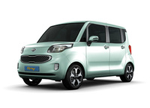
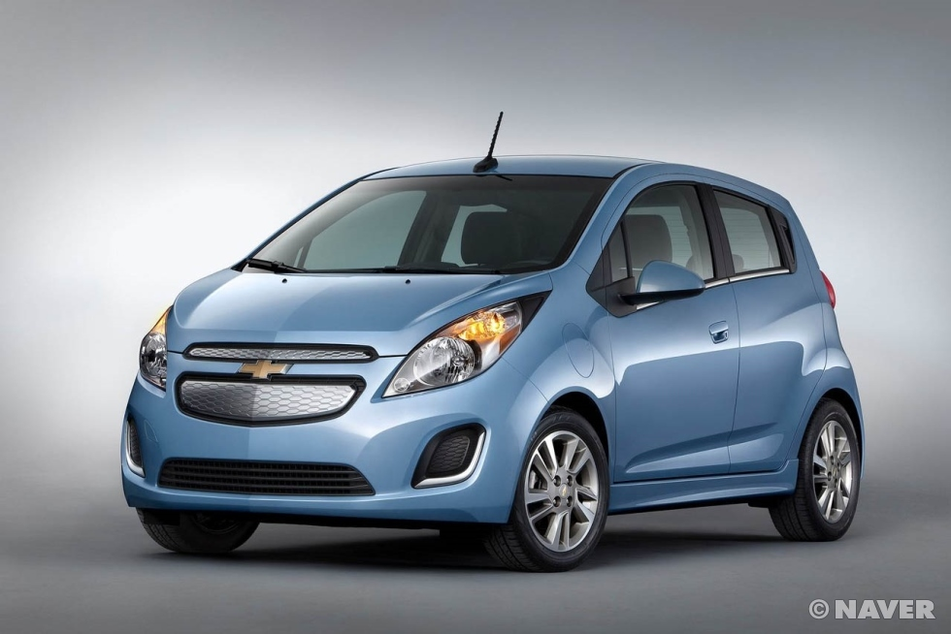
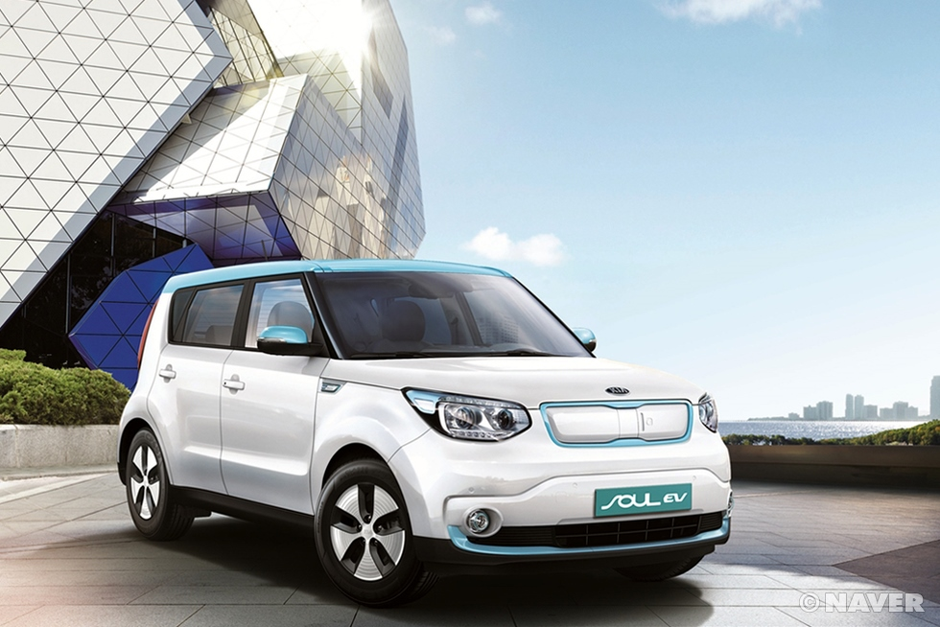
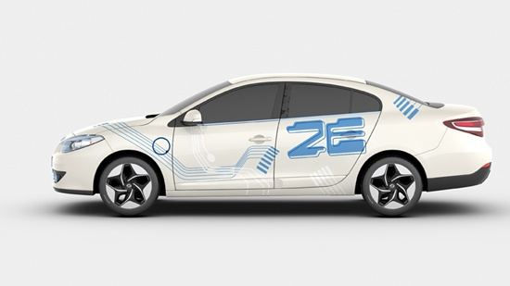
Ⅱ. Market Development of Electric Mobility
□ Electric Vehicles : Setting stretch goal but slow sales
- Popular model change from mini to small
* Kia Ray EV and GMK Spark EV ⇒ Kia Soul EV and RenaultSamsung SM3 EV

Slide 12
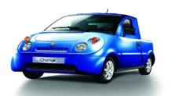
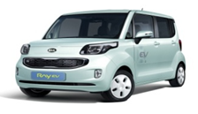
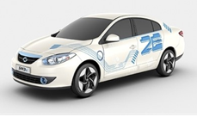
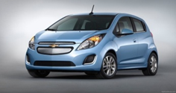
Ⅱ. Market Development of Electric Mobility
□ EV price is falling down
- Kia cut Ray EV price from 45 mil. Won to 35 mil. Won.
- Local government provide subsidy to EV buyers.
* Jeju special self-governing province subsidizes 8 mil. Won.
< Table > Comparison of Electric Vehicle
 | Change (AD Motors) | Ray EV (Kia) | SM3 ZE (Renault Samsung) | Spark EV (KoreaGM)
Models
Size | Mini | Mini | Small | Mini
Maximum speed | 60km/h | 130km/h | 135km/h | 150km/h
One-time charge mileage | 77.9km | 91km | 123km | 135km
Price(ten thousand Won) | 2,100 | 3,500 | 4,250 | 3,990

Slide 13
Ⅱ. Market Development of Electric Mobility
- SM3 ZE demand was three times more than supply in Jeju in 2013.
* Actual purchasing price was 19.5 mil. Won before tax.
cf : average selling price of IC model of SM3 is 17.6 mil. Won.
□ Lack of government purchasing subsidy has hindered sales.
- OEMs also supply EVs in accordance with government’s subsidy.
□ Introducing new mid-size EV models will promote EV sales.
- The sales of imported electric vehicles began to start in the first
half of 2014.
< Table > Government goal for BEV sales
 | 2011 | 2012 | 2013 | 2014 | 2015
Goal | 1,000 | 2,500 | 13,200 | 60,000 | 86,700
Actual Sales | 372 | 714 | 715 | 434 | -

Slide 14
Ⅱ. Market Development of Electric Mobility
- Hyundai will launch Sonata PHEV in 2015 and Avante EV/Hybrid in
2016.
- Kia will introduce K3 EV in 2016.
□ Performance improvement is expected in 2017.
* Electric Cars glide to 200-Mile Range (WSJ. Aug)
- LG Chem. Power Inc. is improving performance of lithium-ion
battery.
< Table > Comparison between Soul and i3
 | Soul | i3
Specification(mm)
Generator capacity(kW)
Battery capacity(kWh)
Mileage(km) | 148
Charging time(Slow/Fast)(hrs/ms)
Max. Speed (km/h)
Price | 4,250

Slide 15
Ⅱ. Market Development of Electric Mobility
□ Mid-range EV price of will be falling down to as low as $30,000
in 2017.
- Representative Model : Soul and Spark EV
- Those models are developed in Korea.
□ Solving price and performance problems by 2020.
- Battery big bang will take place in 2017 and small number of large
battery companies will lead EV battery market.
- Charging time is the remaining problem of EV.
□ Electric vehicle charger : Public fast charger 118(‘13),
109(‘14)

Slide 16
Ⅲ. Supporting Policy for Electric Mobility
□ Construction of Charging Infrastructure
- Limited support for construction
* Fast and Slow charging Infrastructure until 2015
- Registered EV charging station : 177 at the end of June 2014
* 50 more station in the second half of this year
- Installing Dual charger : DC ChaDemo and AC3
- Constructing public fast charging station : 600 by 2017
< Table > Charger deployment plan
unit : thousand
 |  |  | 2011 | 2013 | 2015 | 2020
Electric Charger | Public | Slow | 0.17 | 3.1 | 4.5 | 8
 |  | Fast | 0.07 | 0.12 | 0.6 | 2.6
 | Private | Slow | - | 2.5 | 11.4 | 137.8
 |  | Fast | - | 1.0 | 3.0 | 19.6
 | Total |  | 0.24 | 7.1 | 20 | 168

Slide 17
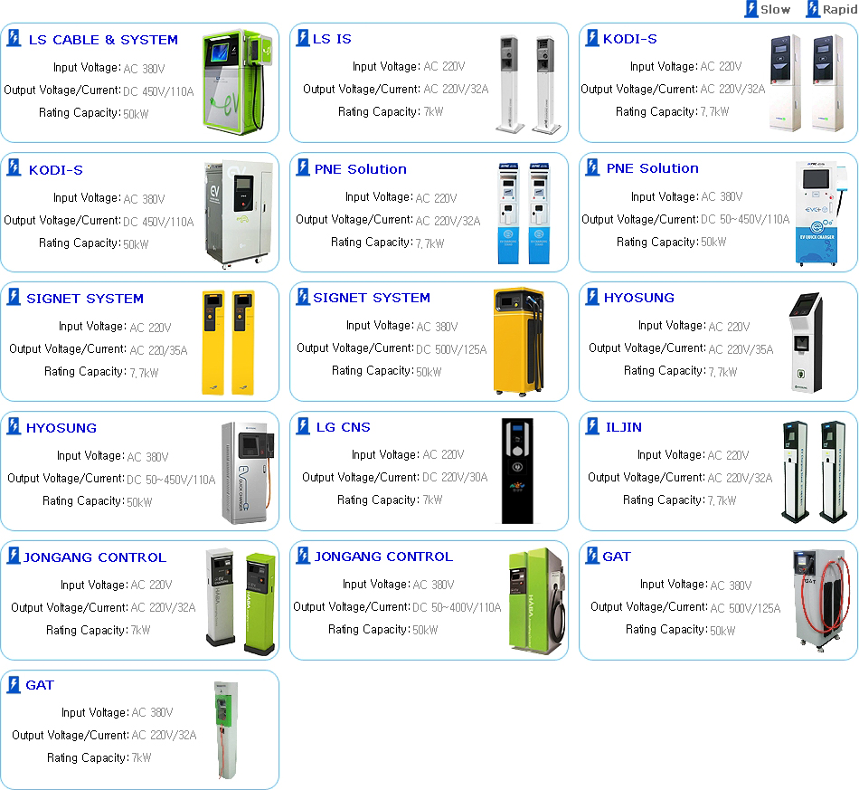
Ⅲ. Supporting Policy for Electric Mobility
< Figure > Charger State

Slide 18
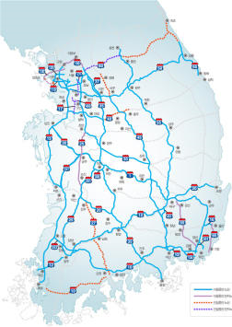
Ⅲ. Supporting Policy for Electric Mobility
□ Installing public fast charging station on Expressway
- 1 station on each side of 3 Rest areas
- More public fast charging stations
alongside the 1 Expressway.
- Current EV (less than 80miles/charging)
can drive from Seoul to Busan in 2015.
□ Build real-time monitoring system
of charging stations
- Operating EV charging information
system
* http://evcis.or.kr
□ Establishing charging service SPC
- Install 5,500 chargers in Seoul and Jeju

Slide 19
Ⅲ. Supporting Policy for Electric Mobility
□ Performance Improvement by Government R&D Support
- Korean government supports EV related R&D continuously and
promotes diffusion of B2B Models related with EV
* EV car sharing, rent car, taxi and battery lease model : falling EV price
- Public purchasing of EV
* Public institutes buy eco-friendly vehicles of 50% for public use
* They should buy EV at least 50% of purchasing
□ FCEV : Hyundai secures mass production technology
- Supply FCEV to local governments
* 40 FCEVs in 2014
- Hyundai aims to sell 1,000 FCEV by 2015 for public use.

Slide 20
Ⅲ. Supporting Policy for Electric Mobility
□ Government supports infrastructure building
- FCEV Proving Ground : Seoul, Kwangju, Ulsan, ChungNam Province
- Fuel Cell Town Project : Ulsan, Pohang
- Using by-product Hydrogen from steel mill & chemical plant.
□ Purchasing subsidy is not decided yet.
- Lack of FCEV charging points
* Negative awareness of the general public for FCEV charging facility
□ FC station : 11 stations as of the end of June 2014.
* Add 2 in 2014 and Expanding to 43 in 2015.
□ Consumers can buy FCEV after 2018

Slide 21
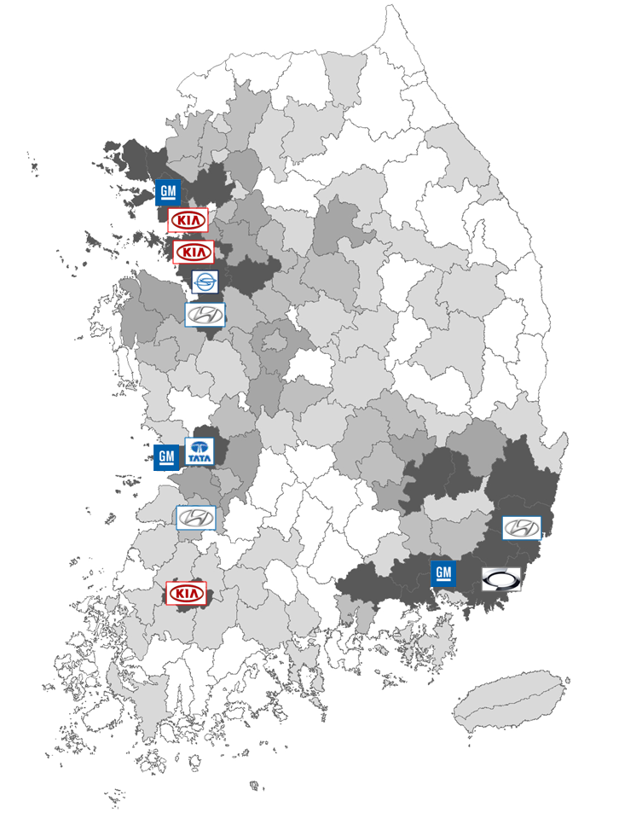
Ⅲ. Supporting Policy for Electric Mobility
< Figure > FCEV Proving Ground and town
FC Town
Proving ground

Slide 22
Ⅲ. Supporting Policy for Electric Mobility
□ Government Role and Supporting Policy
- 2005 is the first year of Hydrogen Economy
- Korean government establish long-term development and
commercialization plan in 2010.
- Detailed R&BD strategy has been developed every year.
⇒ Ministry of Environment : Plan to Introduce “Low-Carbon
Collaboration Fund” in 2015.
- Benchmark Bonus-Malus system of France
* Purchasing subsidy : Electric Vehicle & Low carbon emission vehicle
* Allotment for high emission vehicles
- Government examines reduction of EV subsidy to the level of
developed countries.

Slide 23
Ⅲ. Supporting Policy for Electric Mobility
□ 2030 Smart Eco-friendly Transportation Master Plan of the
Seoul Metropolitan Government
- As of 2013, 751 BEVs and 46 fast charging points are registered.
- Increase BEV registering to 47thousand and fast charging points to
500 by 2020.
- 40 thousand slow home charger and 10 thousand public chargers
by 2020.
- Proceeding EV taxi proving project from Sept. 2014
* 10 RenaultSamsung SM3 EV
- Expanding EV Car sharing fleet from 364 in 2914 to 2,000 in 2020.
- Construct solar cell charging points from 2015

Slide 24
Thank you for your attention

