Slide 1



Issues of Korea’s Electronics Industry and Development Strategies
2014. 11. 22.
Suh, Dong-Hyuk
(Director of Division, KIET)

Slide 2


Contents
Ⅰ
History of the Korea’s Electronics Industry
Korea’s Growth Policies and Strengths for the Cooperation with ASEAN
Ⅱ
Issues and Challenge in Korea’s Electronics
Industry
Ⅲ
Korea’s Strategies in the Electronics Industries
Ⅳ

Slide 3


Ⅰ
History of the Korea’s Electronics Industry

Slide 4

Industry’s Growth for 40 Years
ICT Industry, quantum jump from the 1980s
Leading ICT industry 3.0 era with convergence and smart trends
Upgrade 1.0 : starting for DRAM memory development
  - DRAM memory (1980s)
  - Development of Flat display and HDTV , commercialization of CDMA (1090s)
Upgrade 2.0 : advancement of digital products
- 40 inch LCD(2001), first development in the world
- Flash memory, LCD TV, cell phone, modular parts (2000s)
Upgrade 3.0 : converging and smart industry
- New growth engine, convergence industry (2010s)
- Smart phone, 3D TV, system LSI, flexible display, emotional SW/contents (2010s)
4

Slide 5

Industry’s Growth for 40 Years
ICT Industry, entering the growth path from earlier 80s
Real gross output of the industry, CAGR 27.1% during 1970~90
- 33.5% in 1970s, 20.9% in 1980s
Continuous growth similarly in 1990s, despite two global crises
- CAGR 14.8% during 2000~2010
ICT industry’s Growth in Korea (real gross output)
DRAM
start
Korea-China
diplomatic
digital era
crisis
Mobile device
LED TV
3G phone
nand flash memory
PC
memory
audio
Window PC
large TV
cell phone
colorTV
CRT
Phone
LCD display
PDP/LCD TV
camera phone
5

Slide 6
Export, Dramatic Increase for 20 Years
ICT Industry, higher value-added in export
Export, CAGR 11.4% for the past 20 years
- 33.5% in 1970s, 20.9% in 1980s
Structure of export products, enhanced by flash memory and display
- While driven by PC DRAM, PC, color TV, and audio during 1990s
Korea ICT industry’s Export
6

Slide 7
Strong Trade Surplus
Continuous trade surplus
Trade specialization index(TSI), over 0.25 after mid-1990s
- ICT industry’s TSI, average 0.35 for the last 5 years
Display, remarkable as the highest industry with 0.80 of TSI in 2013
- Mobile phone industry, also maintaining high level
Korea ICT industry’s Trade Specialization Index
7

Slide 8
Korea’s Growth Policies and Strengths for the Cooperation with ASEAN
Ⅱ

Slide 9
Industry’s Growth for 40 Years
ICT Industry, quantum jump from the 1980s
Leading ICT industry 3.0 era with convergence and smart trends
Upgrade 1.0 : starting for DRAM memory development
  - DRAM memory (1980s)
  - Development of Flat display and HDTV , commercialization of CDMA (1090s)
Upgrade 2.0 : advancement of digital products
- 40 inch LCD(2001), first development in the world
- Flash memory, LCD TV, cell phone, modular parts (2000s)
Upgrade 3.0 : converging and smart industry
- New growth engine, convergence industry (2010s)
- Smart phone, 3D TV, system LSI, flexible display, emotional SW/contents (2010s)
9

Slide 10


Industrial Policies 1 : Promotion Stage
until he 1990s, focus on electronics manufacturing
Memory Semiconductor, selected as a target industry in 1985
In 1993, ICT promotion Fund : R&D investment, strategy planning
In 1994, inauguration of the ministry appointed for the ICT
 5-year National Plan for the Communication Business
1961
 Promotion Plan for the Electronic Industry (~1986)
- (1969) Act on the promotion of the electronic industry
1968
 Plan for Development of the Electronic Industry
- (1985) Comprehensive plan for development of semiconductor industry
- (1988) Development of 4M DRAM
1981
 (1992~2000) Highly Advanced National Project
- Development of 256M(+1G) DRAM, HDTV & display, broadband ISDN
 (1993) Establishment of the ICT Promotion Fund
 (1994) Inauguration of the Ministry of ICT
- (1995~2005) Plan for establishment of broadband infrastructure
- (1999) Cyber Korea 21
1990s
10

Slide 11
Industrial Policies 2 : New growth Engine Initiatives
Growth engine : new momentum of Korea’s ICT industry
Continuous investment on ICT industry
Concentration on a few fields with strong growth potential
New cash cow : LCD/ AMOLED display, digital TV, core materials and components
Korea’s New Growth Engines
2001~
2003~
2009~
New 6 technologies
(IT, BT, NT, ET, ST, CT)
10 industries
(44 items, 147 technologies)
3 groups
(17 industries)
Semiconductor, TV, Display, Digital contents
LED, SW, IT convergence, Contents, Secondary battery
11

Slide 12
Korea ICT’s Global Position
High ranking in world competitiveness
Dominant competitiveness in ICT manufacturing
- World top class in major high-tech. goods
 DRAM/Flash memory, display, digital TV, smartphone, and battery
World Market Share of Korea’s Electronics Industry
 | 2000 | 2005 | 2010 | 2011 | 2012 | 2013
Semiconductor | 7.4(3) | 10.5(3) | 14.1(3) | 13.7(3) | 14.6(3) | 16.2(2)
DRAM | 38(1) | 44.7(1) | 59.0(1) | 61.0(1) | 65.6(1) | 62.7(1)
Mobile Phone | 5.0(4) | 19.4(3) | 29.9(2) | 27.5(1) | 29.6(1) | 29.5(1)
Digital TV | 15.8(2) | 20.1(2) | 36.0(1) | 38.6(1) | 42.7(1) | 42.3(1)
LCD Display | 38.0(1) | 40.7(1) | 45.6(1) | 46.6(1) | 49.9(1) | 44.6(1)
Source : iSuppli, Gartner, SA, Displaybank
* ( ) number is world ranking.
12

Slide 13
Korea ICT’s Strengths for Cooperation
Useful experience for industrial development of ASEAN
Pioneer in the digital era: turning point , fast follower in the ICT industry
- Active and speedy responses to the change of global industrial
environment
Training of technical professionals : excellent trainer for industrial competitiveness
 Manpower = Industrial Competitiveness
- Accumulated education program for advanced engineers, high skilled
manpower
- Many appropriate and competent (ready-to-use) engineers, technicians,
and managers for ASEAN countries
Efficient policy-making in the process of ICT industrial development
- Excellent driving force and R&D supports
13

Slide 14
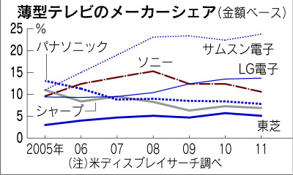
Korea ICT’s Strengths for Cooperation
All of them, successful in catching up with the advanced global firms
- Display, digital TV, battery, and recently some materials of LCD
after DRAM : surpassing Japanese competitors
- From follower to leader in high-tech sectors
Catch-up of ICT Manufacturing
(%)
<Display>
<LCD TV>
25
20
15
10
5
Panasonic
Samsung
LG
Sony
Sharp
Toshiba
05 06 07 08 09 10 11
14

Slide 15
Korea ICT’s Strengths for Cooperation
Accumulated start-ups by ICT incubating system in Korea
Korea’s ICT potential and competitiveness, jumped by a lot of start-ups
created consistently
Officially Certified Venture Companies in Korea
15

Slide 16
Ⅲ
Issues and Challenges in Korea’s Electronics Industry

Slide 17

ICT Industry’s New Paradigm
ICT as an enabler of industry convergence
Making the value-added higher in all other industries as well as ICT
ICT, a core platform beyond just an industry
Improving the quality of life, and changing the lifestyle
 6 Keyword : high efficiency, large storage, realization, intelligence,
convergence, servitization
ICT’s New Roles in All Fields
Automobile
Energy
Shipbuilding
Healthcare
Logistics
Robot
ICT
as an enabler
Lifestyle
Quality
of life
17

Slide 18
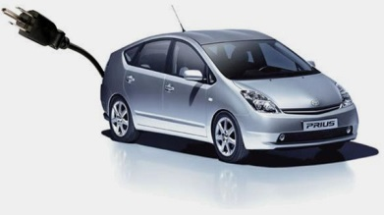
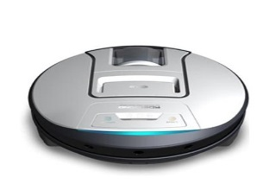
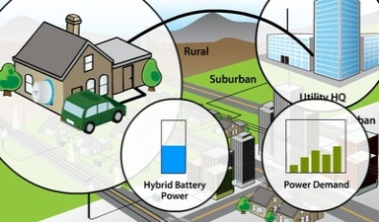
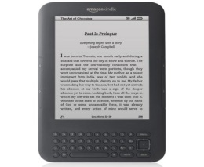
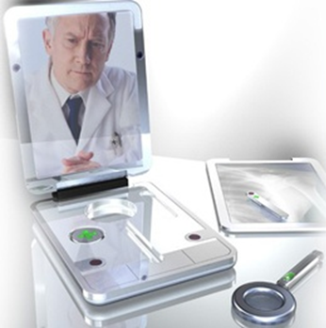
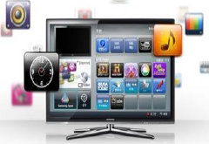
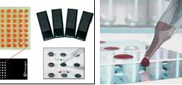
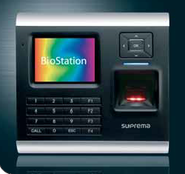
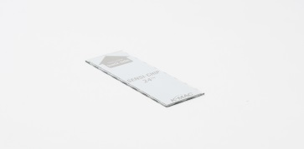
ICT Industry’s New Paradigm
Some cases of industrial convergence by using ICT
Creation of new value like intelligence and smartness through the
convergence products
Expanding Industrial Convergence with ICT
Green
Conve-nience
Green car
Robot cleaner
Smart grid
e-Book
Healthcare
Human-friendly
u-Health
Smart TV
DNA Chip
Biometrics
18

Slide 19

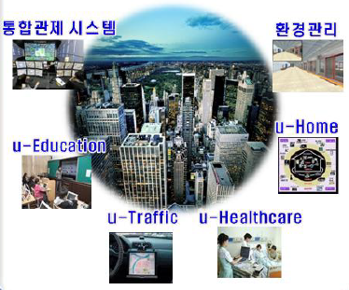
ICT Industry’s New Paradigm
U-city, new attractive space in my life
Smarter and safer in traffic, education, safety, shopping,
environment, and home
SNS, now alive in my everyday life
Facebook(2004), Twitter(2005), Google plus(2002), Line(2011)
ICT Convergence in All Fields
Social Network Service
U-city
Integrated
security control
Environment control
19

Slide 20
Issues in Korea’s Electronics Industry
More intensified competition with China
Chinese companies’ rapid catch-up through the investment, policy
supports
China’s enhancement of the industrial value chain
- Alone, shifting from low-end to high-end products
(smart phone) increasing the R&D and marketing of premium phone
* China’s world market share : 30% close to Korea, 2014
(LCD TV) local market share : about 80% (in world market, 20%)
* Korean firms’ share in China : 8% in volume
(LCD display) world market share 14.5% in 2014, by large investment
(System LSI) surpassing Korea in fabless (in world market, 7%) and
packaging sectors
20

Slide 21
Issues in Korea’s Electronics Industry
Technological gap between Korea and China, more reduced in high
technological and value-added products
China, Improving Industrial Competitiveness
Buyer
role
Korea
Japan
C
✦
C
✦
China
J
J
Supplier
role
material
Core part, equipment
General part
Final and set good
21

Slide 22
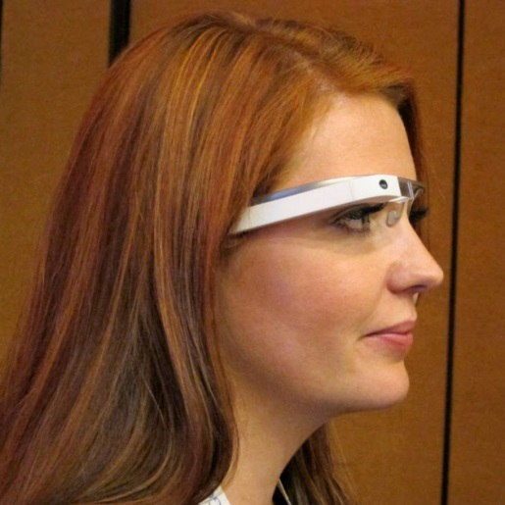
Issues in Korea’s Electronics Industry
Promotion of up-stream sectors
Relatively less competitive up-stream fields, as compared with set
industries
Insufficient value chain in terms of global competitiveness
- High technologies of materials and core components needed for
making sure of the industrial leadership
Necessity of response for the convergence trend
Probably, every innovative goods, created by convergence with ICT
- Factors of affecting competiveness : consumer needs, sensitivity,
value, convenience, networking, open innovation
Apple iphone, followed by smart glass, smart watch and band …..
- New challenges requiring the sophisticated
innovation, waiting for Korea’s ICT industry
22

Slide 23
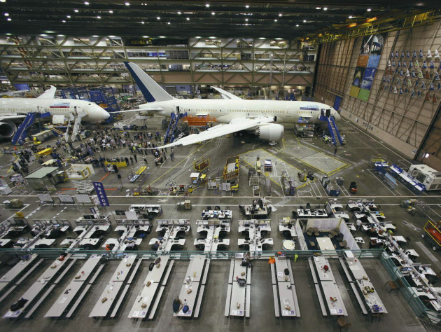
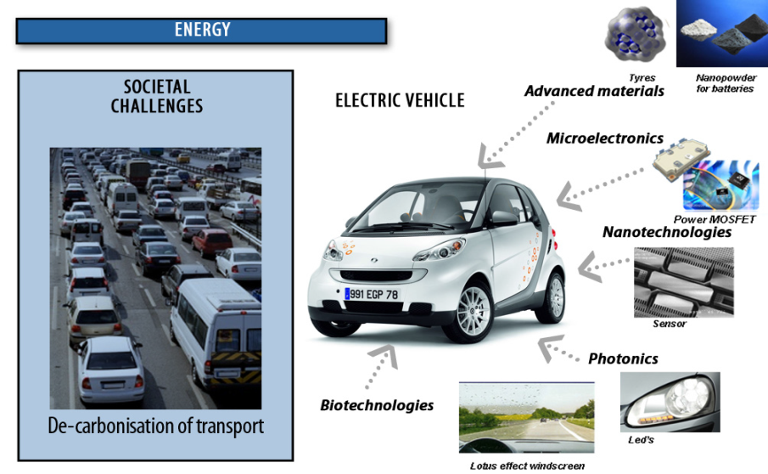
Issues in Korea’s Electronics Industry
Even electric car and Boeing, now converged by ICT and carbon fiber
23

Slide 24
Ⅳ
Korea’s Strategies in the Electronics Industry

Slide 25


Mid and Long-term Strategies
ICT-wave Strategy : From world best ICT to improving QOL
Eco-system in industry, enhancement of life in living space
World
Best ICT
Vitalizing
Industry
Activating
R&D Ecology
Enhancing
Life
Open ICT R&D for world-class
ICT competitiveness
ICT R&D supporting system
for performance
Innovative upgrade of
R&D environment
ICT R&D expansion for improving QOL
InformationR&D
Industry
R&D
ICT convergenceR&D
~’03
’03
~’07
’12~
25

Slide 26


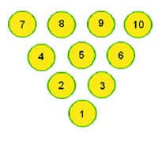
Developing Smart-link Fields for Convergence
Step-up for stronger industrial convergence
Improvement of convergence competence in the technologies and
products for both ICT and other industries
Need to focus on kingpin or linchpin(=smart-link function) in future
promising sectors
What we need now is ……. an industrial impact …. like ‘butterfly effect’
Kingpin !!
26

Slide 27
Refining Global Value Chain in Asia
Active responses to global competition
Re-design of the stable structure of value chain in the industry
Highly desirable for Korea to improve the global value chain(GVC)
of the ICT industry
ICT Industry’s Competition Position in Asia
Strong
Korea
Taiwan
Japan
Value Chain
Stability
Weak
Strong
China
Weak
Response power to Globalization
27

Slide 28
Refining Global Value Chain in Asia
China, as a fast follower in global strategy curve
Another crisis? or jump again? …. for Korea ICT industry
Global value chain(GVC), being the main target of the Korea’s ICT
- Post-smart phone, next generation semiconductor, post-LCD display,
secondary battery, sensor, automotive application component
Global Strategy Curve in ICT Industry
High-tech,
Application device,
Material,
Equipment
Global Strategy Curve
in ICT industry
Japan
Korea
China
Assembly/Manufacturing
28

Slide 29

Upgrading Korea’s ICT manufacturing
Shift from high level stage to premium industry
Challenge for Korea’s ICT : from fast follower to first mover
- Embedded SW and system LSI, counted as the big weakness
To upgrade the industry, in need of more dominant intangible assets,
differentiated technologies, and creativity especially
Korea ICT’s Goal : High-class Premium Industry
Total solution,
System LSI,
Smart component,
Converged goods,
IoT
High-tech. HW,
Mobile device
SW
Middle-tech. HW
Korea ICT
Manufacturing
follower
fast follower
first mover
29

Slide 30
Upgrading Korea’s ICT manufacturing
Smile curve toward up-stream fields
Smile curve what Korea should be : design, engineering, SW, and
core components …
Smile Curve With Going up of Up and Down-stream
Enhancement of
high value-added fields
high
Brand, Channel,
Solution
R&D,
SW, Design,
Engineering
Profitability
(value-added)
Logistics, A/S
Core Component, Material
General Part,
Assembly
low
Up-stream
Value chain
Process
Down-stream
30

Slide 31
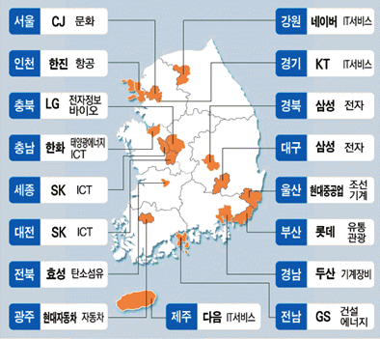
Supporting firms through Innovation Center
Leading the innovation of the whole manufacturing by ICT
‘Innovation centers’ planned for Korea’s creative economy, expected
to drive by conglomerates and small firms/start-ups
More than half of new selected centers, corresponding to ICT industry
New Selected Innovation Centers in Korea for Innovation









: ICT-related sector

31

Slide 32
Advancing the Industrial cooperation with ASEAN
Building of partnership between Korea-China-ASEAN
Effective allocation of up-stream and down-stream in China and
ASEAN countries
- to contribute to development of ASEAN ICT industries
Bilateral cooperation of technologies and human resources in the
ICT industry
- to co-evolve each other to be a successful partner
Cooperation and Co-evolution in ICT Manufacturing
Improvement of Global Value Chain
Cooperation among Korea-China-ASEAN
Co-evolution of ICT Industry
New Industrial Paradigm
32

Slide 33



Thank you !!

