Slide 1
KIET Korea Institute for Industrial Economics and Trade
Economic Effects of the Emission
Trading System on the Korean
Manufacturing Industries
Ki-Ju Han, Ph.D.
Senior Research Fellow, KIET
2010 TIER-RIETI-KIET Workshop
Taipei, Taiwan
November 29, 2010

Slide 2
Korea’s GHG Mitigation Target
2020 midterm GHG mitigation target
- Announced on 4 August 2009
30% reduction from BAU
1990 298 mil.tCO2e, 2020 BAU 813 mil.t CO2e → 569 mil.tCO2e
→ Considering rapid Korea’s GHG emission trend,
very ambitious and robust target

Slide 3
GHG reduction Policies
Various policy measures are being considered, including emission trading scheme
‘The Basic Act on Low Carbon, Green Growth’, enacted in December 2009 includes ETS
Scheduled to be introduced from 2013
Currently, detail contents are under examination

Slide 4
There are a number of difficult factors to be determined in the emission trading scheme
eg.: emission reduction target by sector, allocation process(grandfathering vs. auction), sectors/installations to be covered, MRV, and et.cet.
Equity problem, impact on international competitiveness, and so on.

Slide 5
Particularly, impact on the international competitiveness of the manufacturing sector is a crucial issue
- How to avoid the deterioration of international competitiveness due to the implementation of the ETS?
To find the answer, need to analyze its economic effects on the manufacturing sector

Slide 6
Forecasting GHG emission amount
Basic Method
Forecasting energy consumption by energy sources of each manufacturing sectors
Apply IPCC’s emission coefficients of each energy sources to this estimated energy consumption

Slide 7
Energy Consumption Outlook
- Factors determining energy consumption:
Economic activities, energy structure, energy efficiency, population, energy policies including energy price policy, and et.cet.
- Forecast each factors based on the currently available best information on them

Slide 8
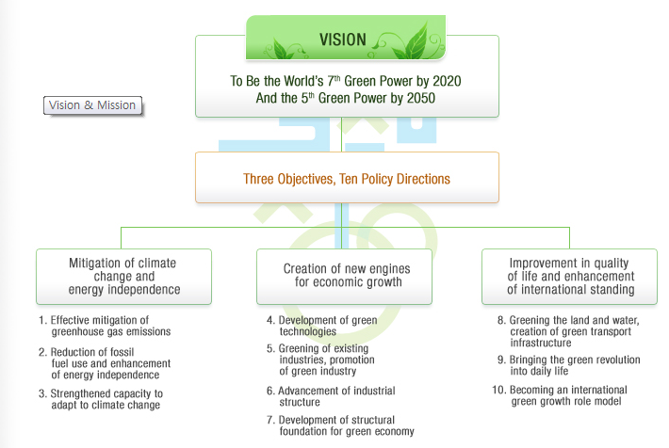
Five-Year Action Plan for Green Growth

Slide 9
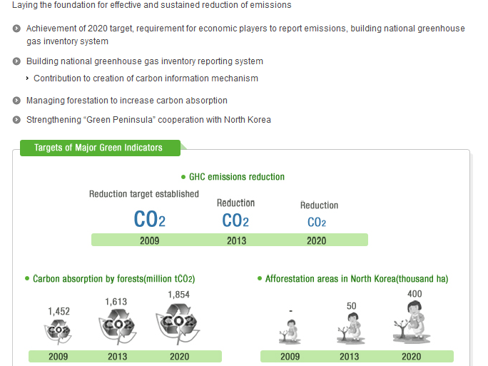
1. Effective mitigation of GHG emissions

Slide 10
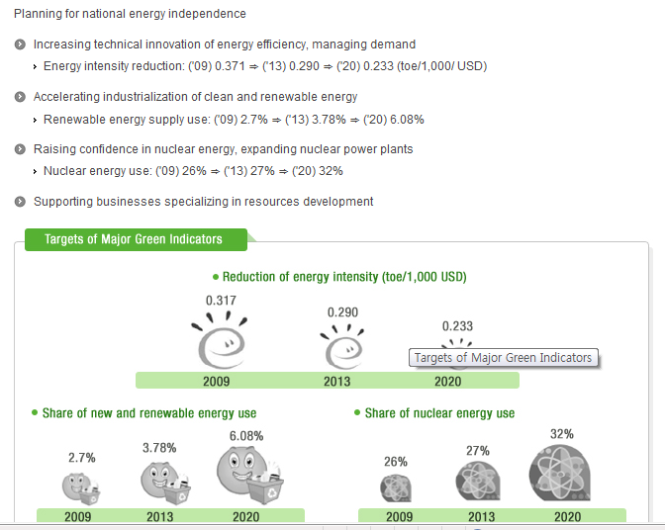
2. Reduction of fossil fuel use & enhancement of energy independence

Slide 11
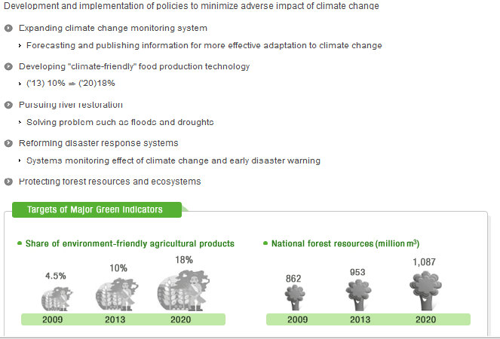
3. Strengthened capacity to adapt to climate change

Slide 12
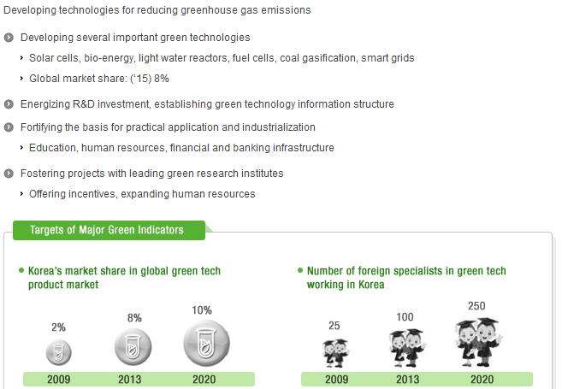
4. Development of green technologies

Slide 13
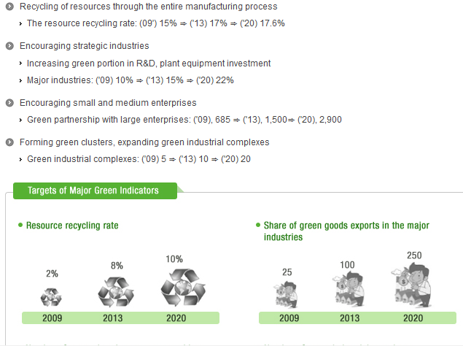
5. Greening of existing industries, promotion of green industry

Slide 14
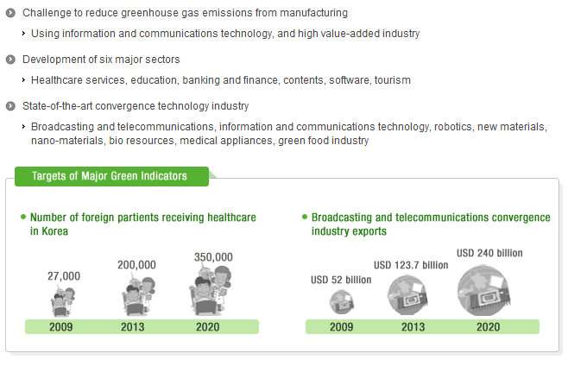
6. Advancement of industrial structure

Slide 15
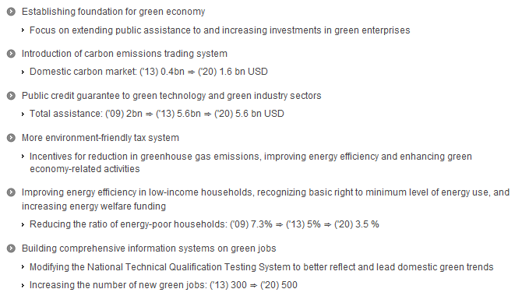
7. Development of structural foundation for green economy

Slide 16
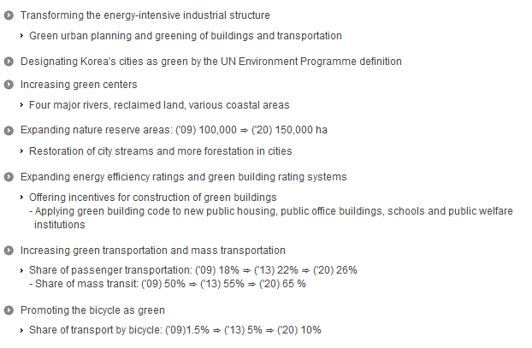
8. Greening the land & water, creation of green transport infrastructure

Slide 17
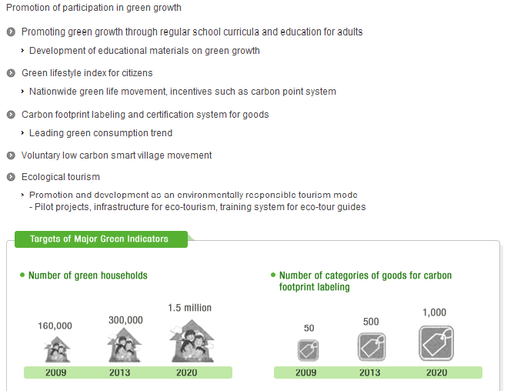
9. Bringing the green revolution into daily life

Slide 18
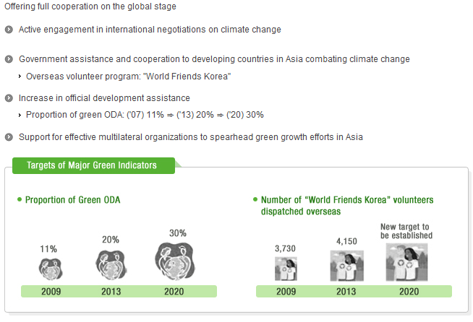
10. Becoming an international green growth role model

Slide 19
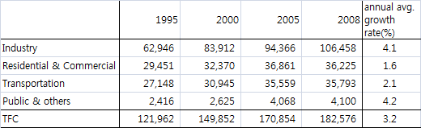
Energy Consumption Structure by Sector

Slide 20
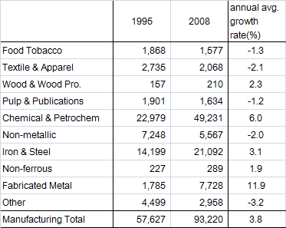
Energy Consumption of the manufacturing Sector
Unit: 1000 toe

Slide 21
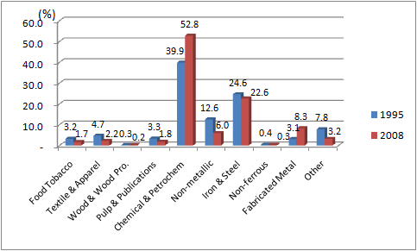
Shares of energy consumption in the mfg. sector(1995, 2008)

Slide 22
GHG emissions unit: mil. tCO2eq.
 | 1990 | 2000 | 2007 | Annual Average Growth Rate(%)
Energy Sector | 247.8 (81.1) | 438.8 (82.1) | 525.4 (84.7) | 4.5
Industrial Process | 19.9 (6.5) | 58.3 (10.9) | 60.9 (9.8) | 6.8
Agriculture | 15.2 (5.0) | 20.6 (3.9) | 18.4 (3.0) | 1.1
Wastes | 22.5 (7.4) | 16.7 (3.1) | 15.3 (2.5) | -2.2
Total Emission | 305.4 (100.0) | 534.4 (100.0) | 620.0 (203.0) | 4.3
Sink | -23.7 | -37.2 | -36.3 | 2.5
Net Emission | 281.6 | 497.1 | 583.7 | 4.4

Slide 23
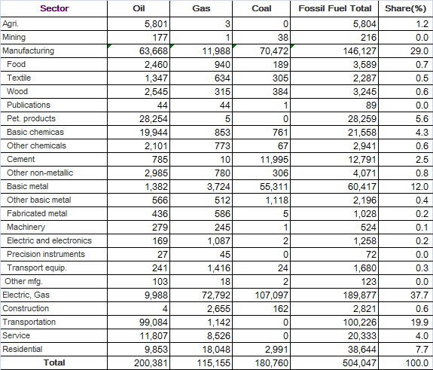
CO2 emissions from fossil fuel combustion(2007)
Unit: 1000 tCO2eq.

Slide 24
CO2 emission outlook from fossil fuel combustion
Estimated for all economic sectors in 2013 and 2020
Only CO2 emissions from fossil fuel combustion are estimated
CO2 emissions from electricity consumption also estimated

Slide 25
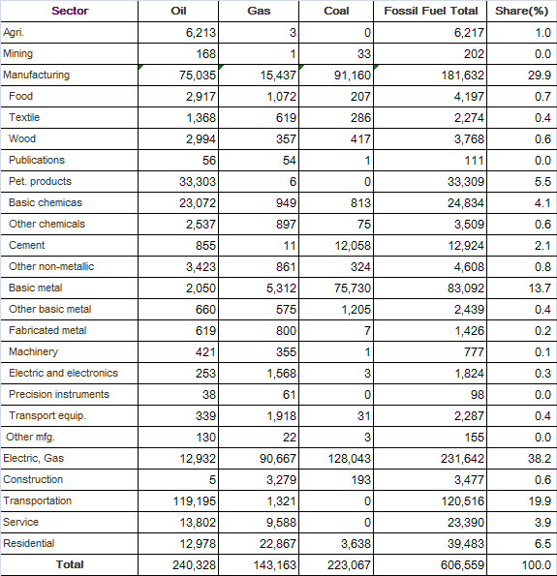
CO2 emissions from fossil fuel combustion(2013)
Unit: 1000 tCO2eq.

Slide 26
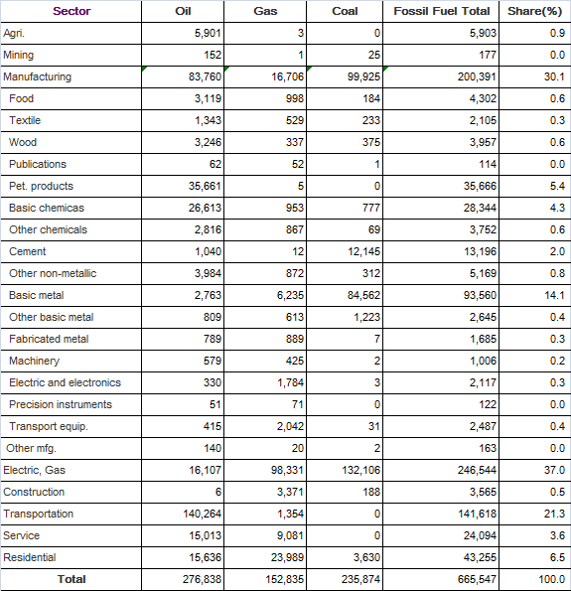
CO2 emissions from fossil fuel combustion(2020)
Unit: 1000 tCO2eq.

Slide 27
Estimation of the economic effects
ETS Scenario
Reduction Cap scenario(reduction relative to the BAU level)
• Manufacturing: 3% and 6% in 2013
10% and 20% in 2020
• Power sector: 2% and 4% in 2013
4% and 8% in 2020
Allocation of the emission right
• Grandfathering in 2013
• Grandfathering and 50% auction scenario in 2020

Slide 28
<Scenario>
 | Scenario | Reduction rate(%) |  | Credit Allocation
 |  | Mfg. | Power
2013 | A-1 | 3 | 2 | grandfathering
 | A-2 | 6 | 4 | grandfathering
2020 | B-11 | 10 | 4 | grandfathering
 | B-12 | 20 | 8 | grandfathering
 | B-21 | 10 | 4 | 50% auction
 | B-22 | 20 | 8 | 50% auction
Price of emission credit is assumed to be 50,000 Won
(about US $43)

Slide 29
Each industry has to reduce its emissions to the allocated cap
- By the introduction of the emission reduction
technology including CCS, optimizing energy
efficiency, energy conversion, and so on.
- If some amounts still remain even with these methods, emission credits have to be bought.

Slide 30
Economic effects are dependent upon compliance costs
Compliance costs are composed of abatement costs and the expenditures on the emission credit
• These costs are dependent upon GHG
abatement potentials and costs
→ Very uncertain and difficult to estimate

Slide 31
Industries argue that there are very few room for curtailing GHG emissions
Due to high energy efficiency
High emission reduction would entail significant cost burden, resulting in shrinking economic activities and deteriorating international competitiveness
Strongly oppose high GHG reduction obligation
- On the other hand, the Korean government is likely to think that there are more rooms

Slide 32
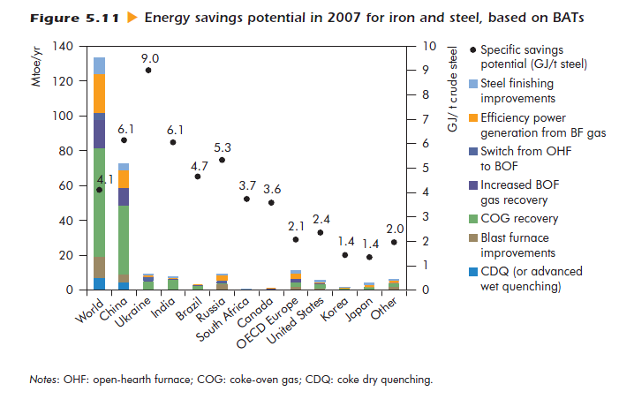
Source: IEA/OECD, Energy Technology Perspectives 2010, 2010.

Slide 33
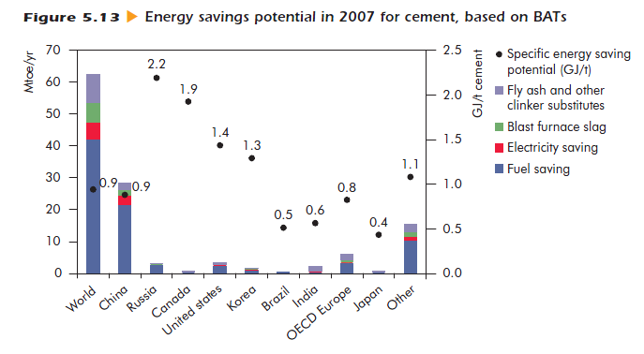
Source: IEA/OECD, Energy Technology Perspectives 2010, 2010.

Slide 34
For this reason, we used the McKinsey’s case study result
* McKinsey&Company, Costs and Potentials of Greenhouse Gas
Abatement in Germany, 2007.
- Abatement potential and costs of each manufacturing sector are estimated based on the McKinsey’s result

Slide 35
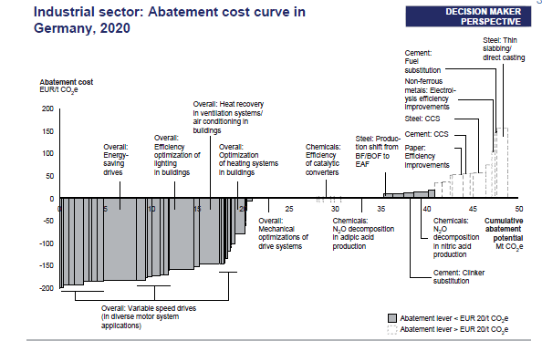
Source: McKinsey(2007)

Slide 36
Total cost increase consists of the following two factors
Abatement costs(technology costs and emission credit purchasing costs)
Emission credit purchasing costs due to the auction

Slide 37
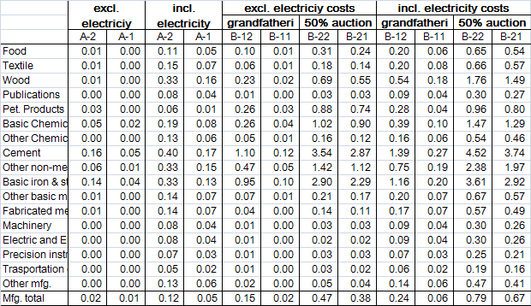
Costs increasing rate due to ETS (%)

Slide 38
Economic effects are estimated by the general equilibrium model
- Consumption is defined as a social welfare
- Secure optimization by maximizing the consumption
- First effect by the introduction of the ETS is captured by the change in the input costs such as energy costs

Slide 39
Government’s revenue from selling emission credits
are assumed to be returned to the service sector
Macro economic effects of the ETS
Unit: change rate(%)
 | 2013 |  | 2020
 | A-1 | A-2 | Grandfathering |  | 50% auction
 |  |  | B-11 | B-12 | B-21 | B-22
GDP | -0.02 | -0.04 | -0.04 | -0.18 | -0.25 | -0.36
Employment | -0.01 | -0.03 | -0.03 | -0.12 | -0.01 | -0.10

Slide 40
Macro economic effects of the ETS by economic sectors
Unit: change rate(%)
 | 2013 |  | 2020
 | A-1 | A-2 | Grandfathering |  | 50% auction
 |  |  | B-11 | B-12 | B-21 | B-22
Agriculture | -0.01 | -0.01 | -0.02 | -0.09 | -0.06 | -0.13
Mining | -0.11 | -0.32 | -0.32 | -1.94 | -4.55 | -5.73
Manufacturing | -0.01 | -0.03 | -0.03 | -0.20 | -0.41 | -0.54
Electricity, Gas | -0.21 | -0.50 | -0.53 | -1.19 | -3.33 | -3.85
Construction | -0.004 | -0.01 | -0.01 | -0.03 | +0.41 | +0.36
Service | -0.01 | -0.04 | -0.03 | -0.12 | +0.02 | -0.07

Slide 41
Policy Implications
Estimation result that GHG emissions will increase most rapidly in manufacturing and transportation sector implies that it is essential that GHG emissions of the transportation sector also has to be substantially reduced as well.
2. The result that the economic effects are much different when emission credits are grandfathered and when auctioned suggests that allocation of the credits is one of the most important factors in the ETS.

Slide 42
3. The result that economic impact on the economy significantly differs according to the methods that government’s revenue from the auction of the credits is used implies that the government has to be very careful in the way of using the revenue.

Slide 43
Thank you
Note: All of the estimates in the paper are
preliminary ones so need to be used only for
reference.

